Slide 1


Registering & Updating Your Account

Slide 2
Signing Up a Single Location Practice

Slide 3
Overview
Click by click:
Signing up a single location Open Internet Browser| https://my.previser.com | Last Name | Office Phone Number| Postal Code | Find My Practice | Select Correct Doctor or Continue | Username | Password | Verify all pre-populated fields | Account Email | Position | Individual NPI | State | State License # | PIN | End Users License Agreement| Complete Registration Open email | Activate your Account | Username | Password | PIN

Slide 4
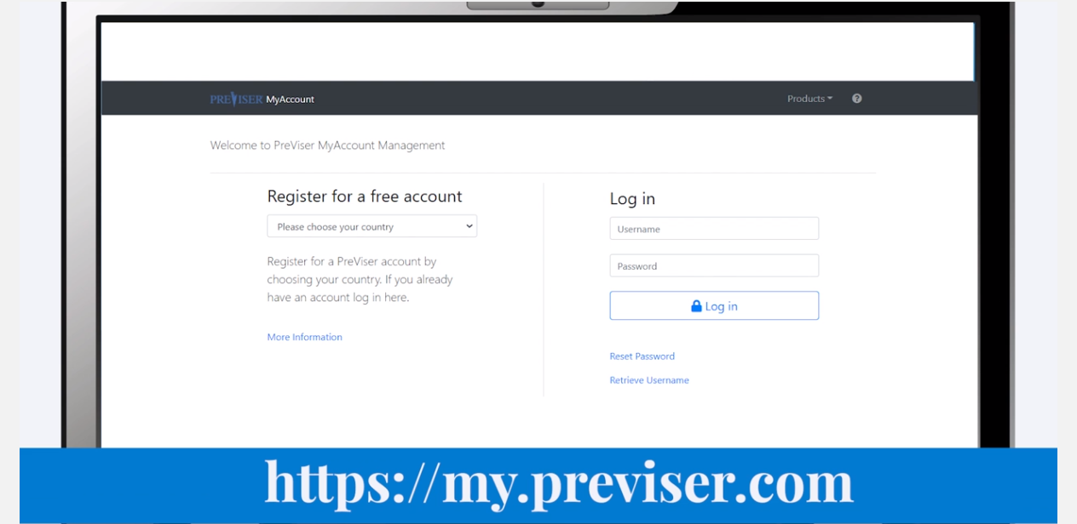
Click by click:
Open web browser and go to https://my.previser.com

Slide 5
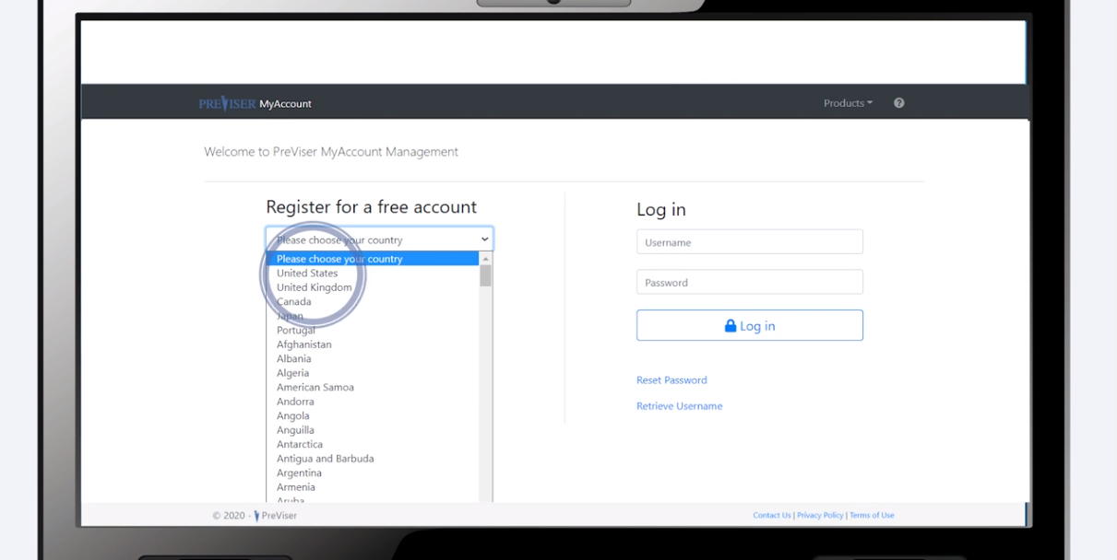
Click by click:
Choose your country

Slide 6
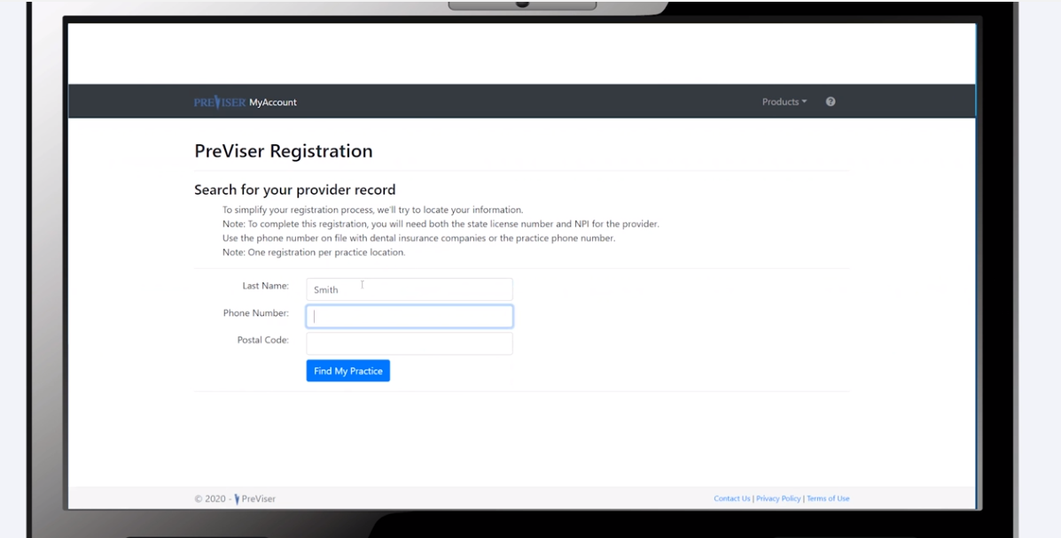
Click by click:
Enter in the provider’s last name, office phone number and postal code

Slide 7
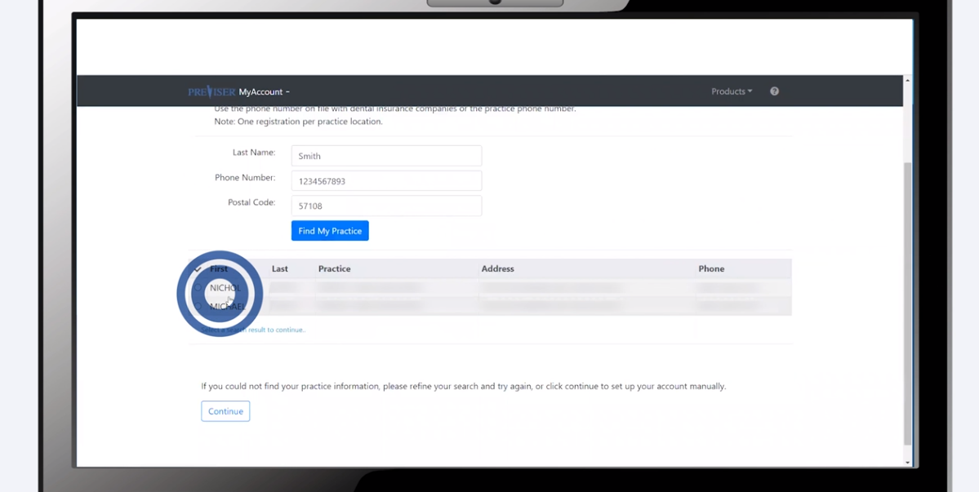
Click by click:
Select your providers name or “Continue”

Slide 8
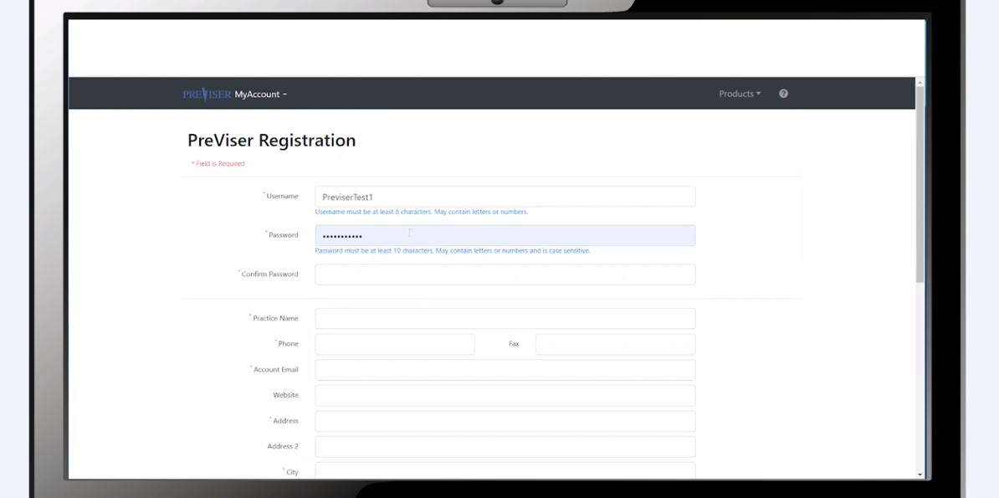
Click by click:
Create a username, password and fill out the rest of the required fields

Slide 9
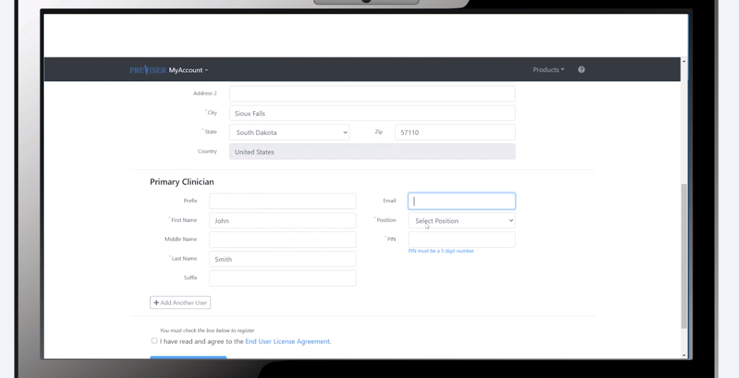
Click by click:
Enter in the primary clinician information

Slide 10
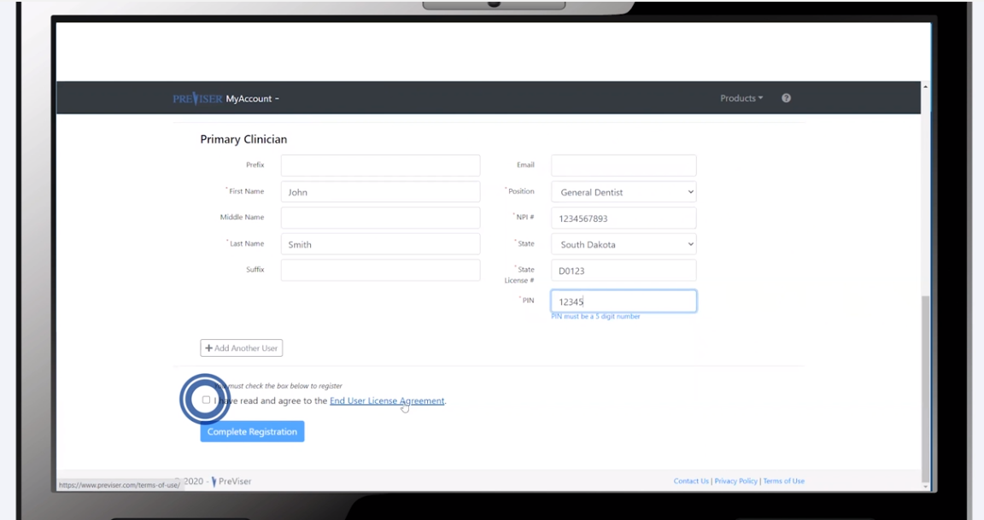
Click by click:
Read the End User License Agreement and select “Complete Registration”

Slide 11
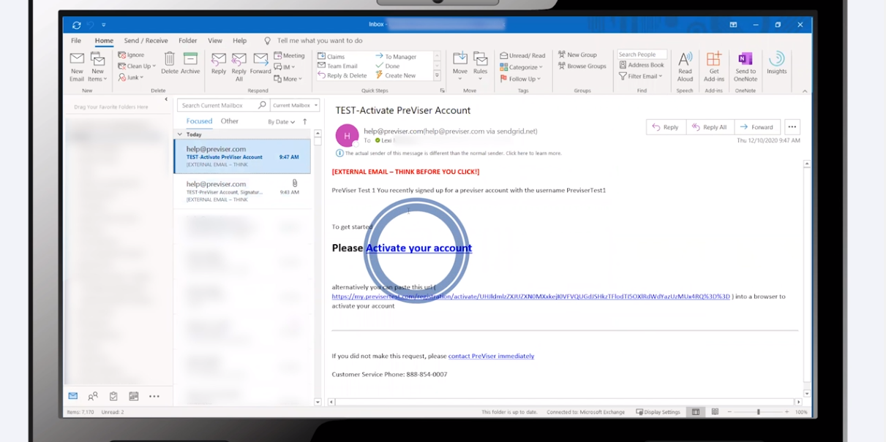
Click by click:
Open the email from PreViser and select “Activate your Account”

Slide 12
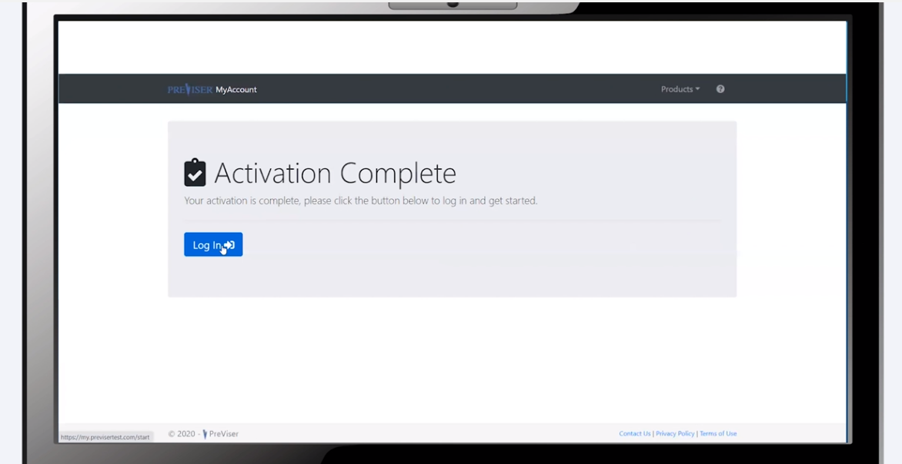
Click by click:
Select “Log In”

Slide 13
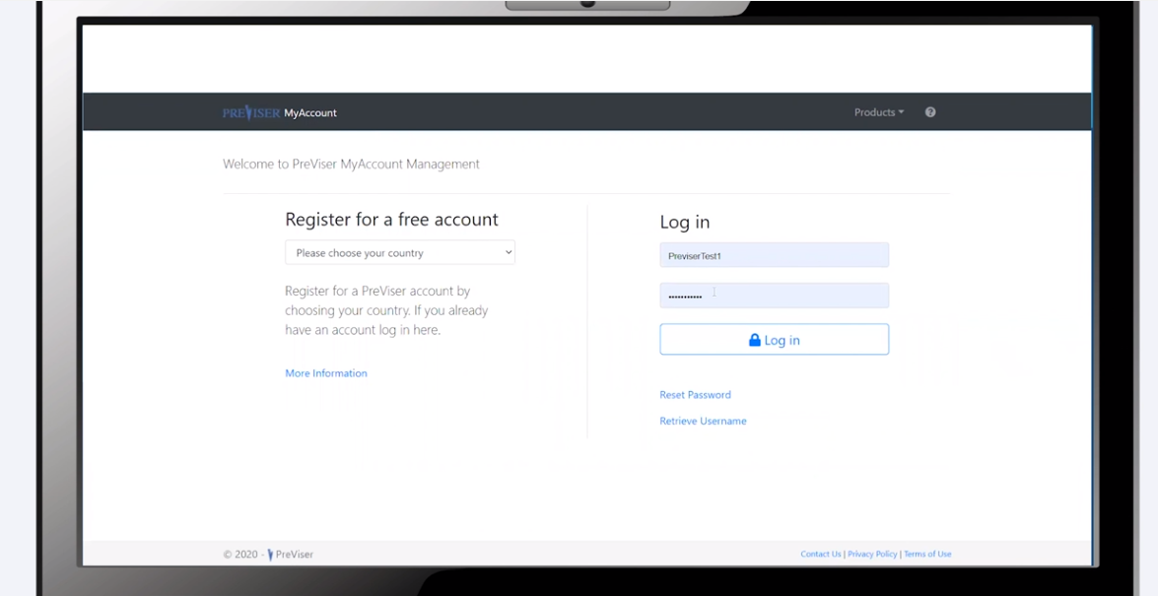
Click by click:
Log in

Slide 14
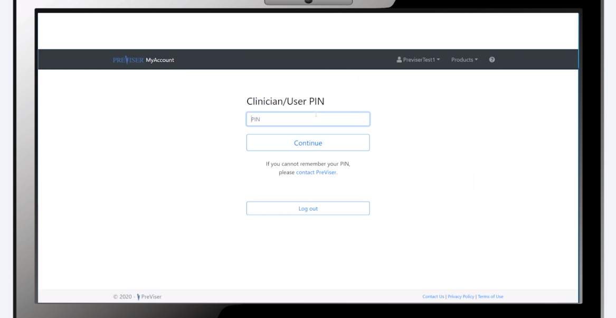
Click by click:
Enter in pin number and add other employees

Slide 15
Create Shortcut on Desktop

Slide 16
Overview
Click by click:
Create Shortcut on Google Chrome Open Google Chrome | https://secure.previser.com/clinical | Select 3 Dots | More Tools | Create Shortcut | Enter Shortcut Name | Create | Test Shortcut
Create Shortcut on Internet Browser Open Internet Browser | https://secure.previser.com/clinical | Copy URL | Go to Desktop | Right Click | New | Shortcut | Paste URL | Next | Enter Shortcut Name | Finish | Test Shortcut

Slide 17
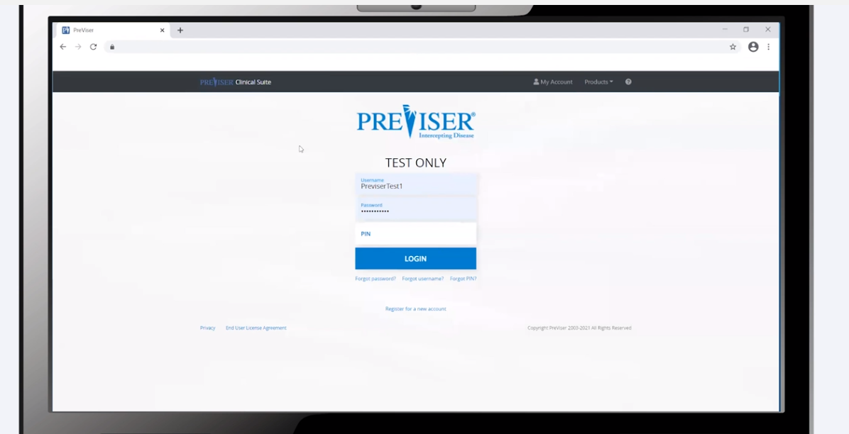
Click by click:
Open Google Chrome and go to https://secure.previser.com/clinical

Slide 18
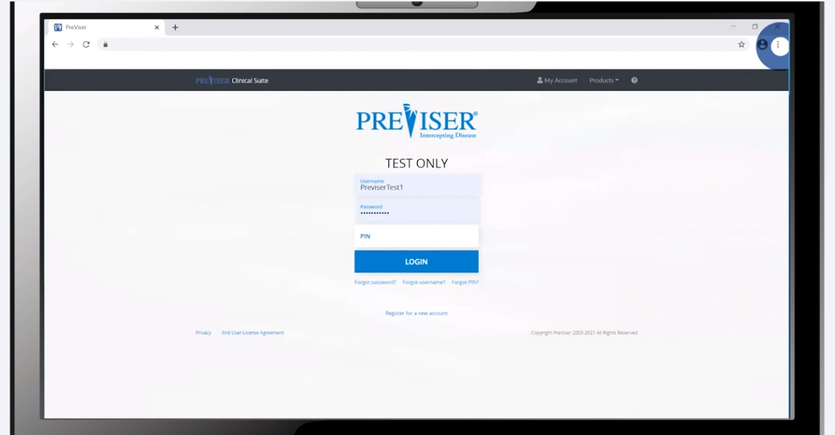
Click by click:
Select 3 dots in top right corner

Slide 19
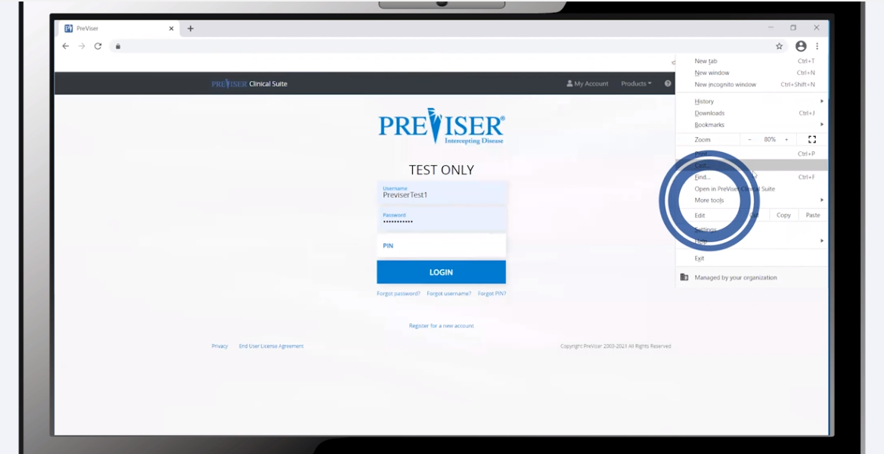
Click by click:
Select “More tools”

Slide 20
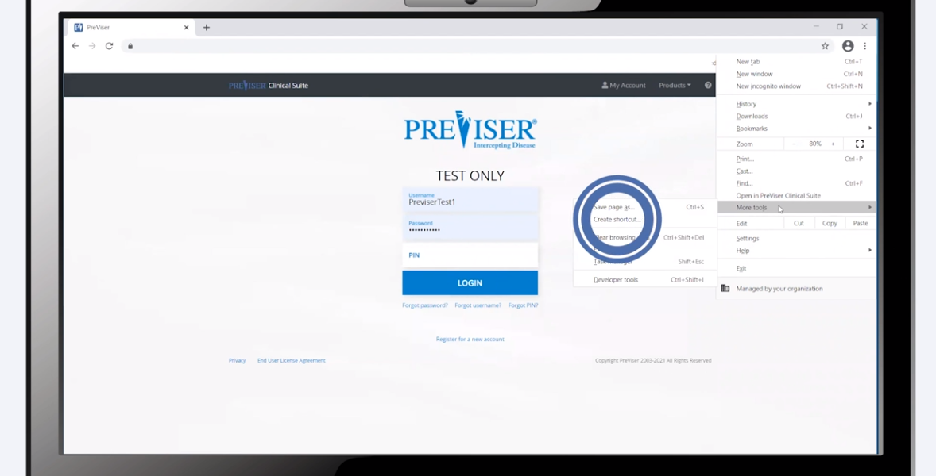
Click by click:
Select “Create Shortcut”

Slide 21
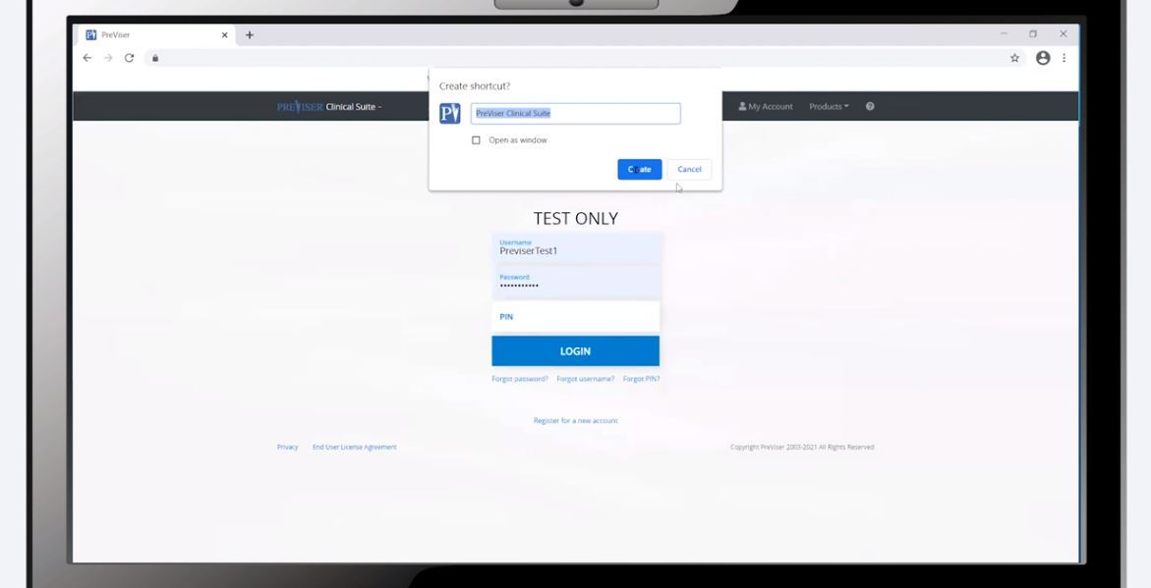
Click by click:
Enter in shortcut name and select “Create”

Slide 22

Click by click:
Test shortcut

Slide 23
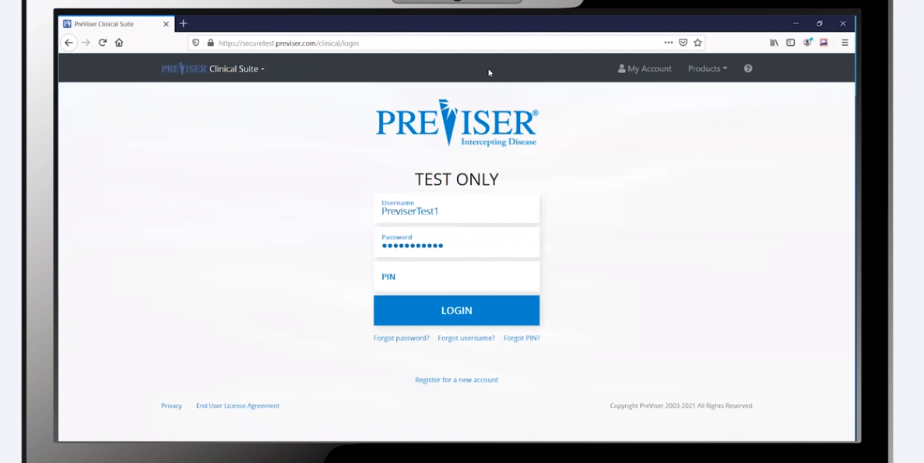
Click by click:
Open internet browser and go to https://secure.previser.com/clinical

Slide 24
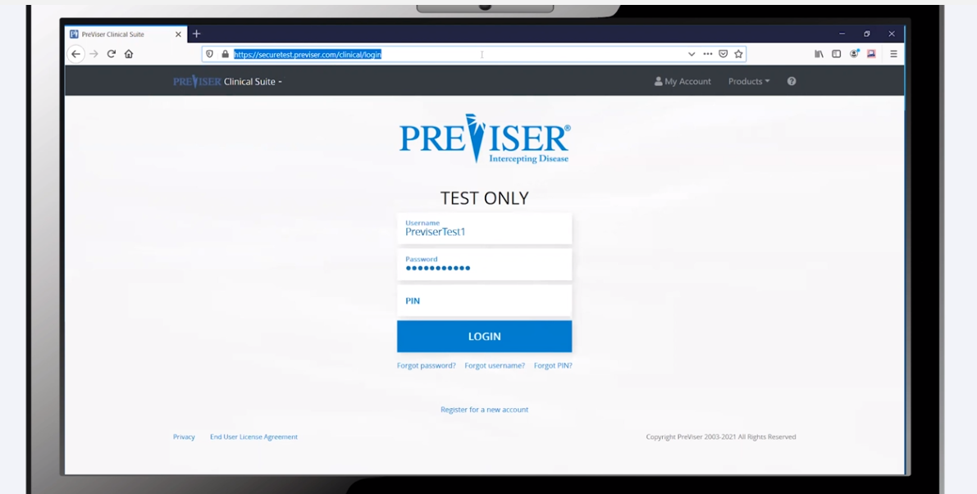
Click by click:
Highlight URL and select “copy”

Slide 25
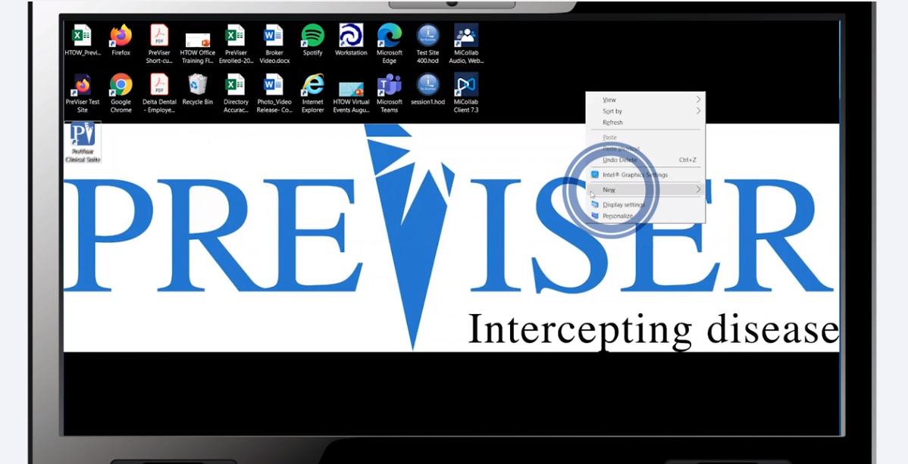
Click by click:
Go to desktop and right click. Select “New”

Slide 26
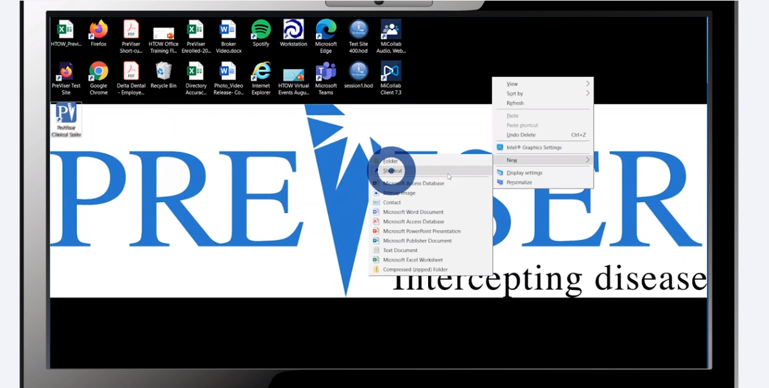
Click by click:
Select “Shortcut”

Slide 27
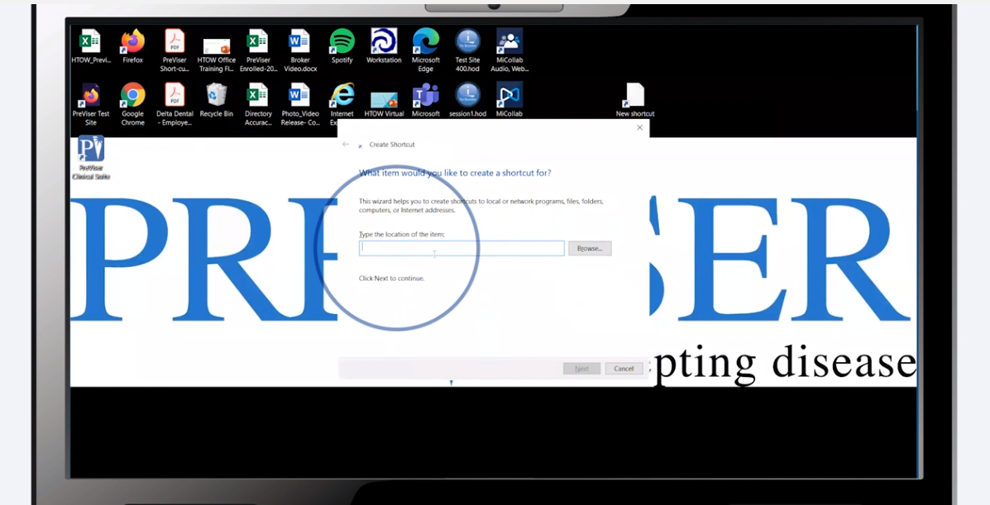
Click by click:
Paste the URL into the search box

Slide 28
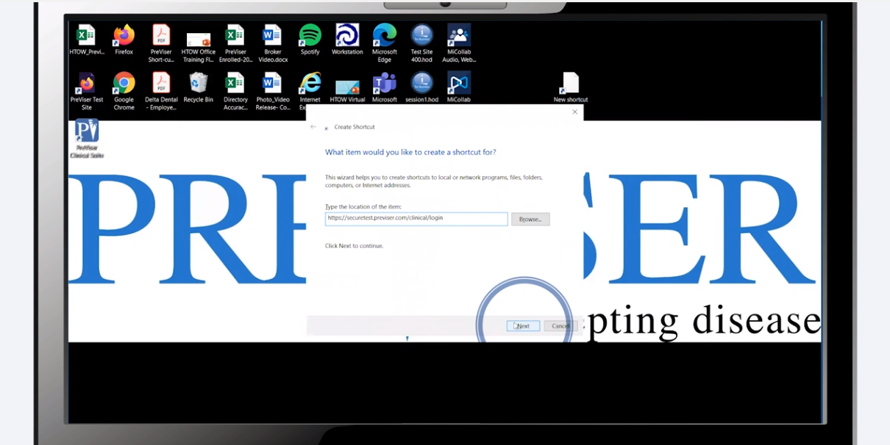
Click by click:
Select “Next”

Slide 29
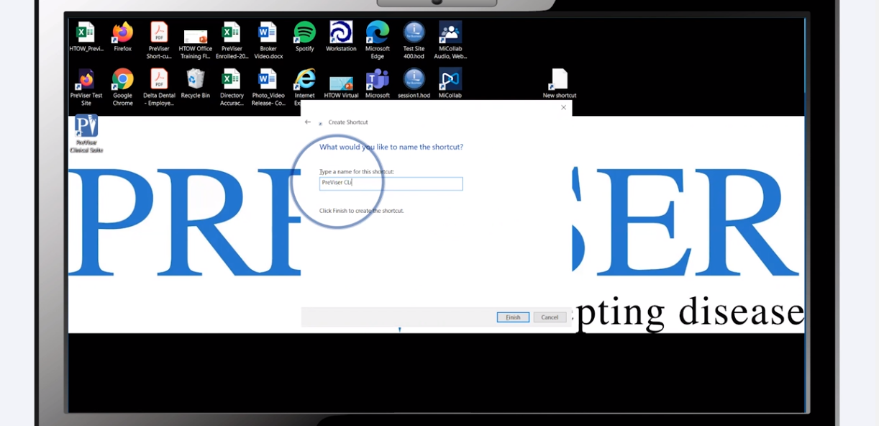
Click by click:
Enter in shortcut name

Slide 30
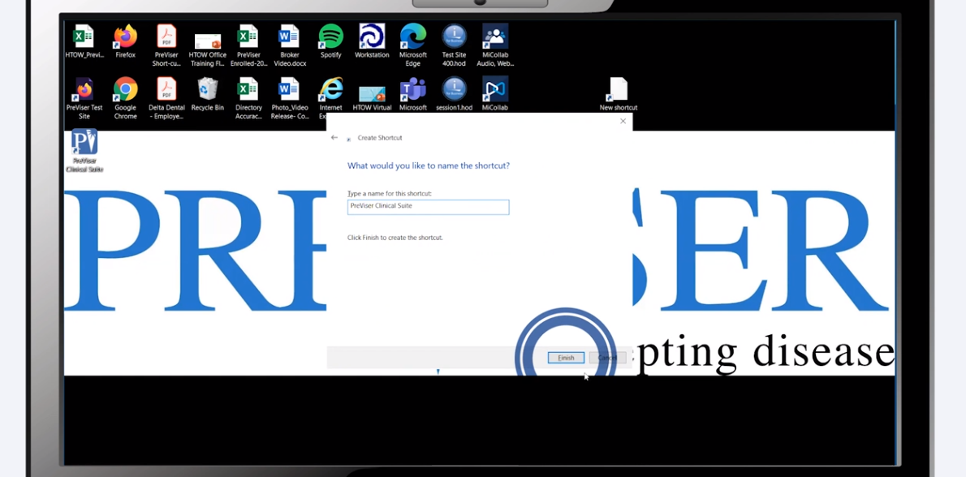
Click by click:
Select “Finish”

Slide 31

Click by click:
Test shortcut

Slide 32
Create Shortcut on Tablet

Slide 33
Overview
Click by click:
Create Shortcut on a Tablet Open Safari | https://secure.previser.com/clinical | Select Up Arrow | Add to Home Screen | Enter in Shortcut Name | Add | Test Shortcut

Slide 34

Click by click:
Open Safari

Slide 35
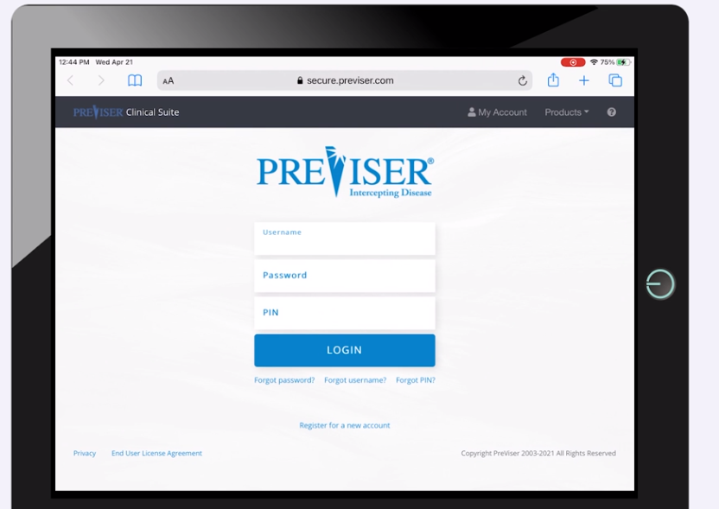
Click by click:
Go to https://secure.previser.com/clinical

Slide 36
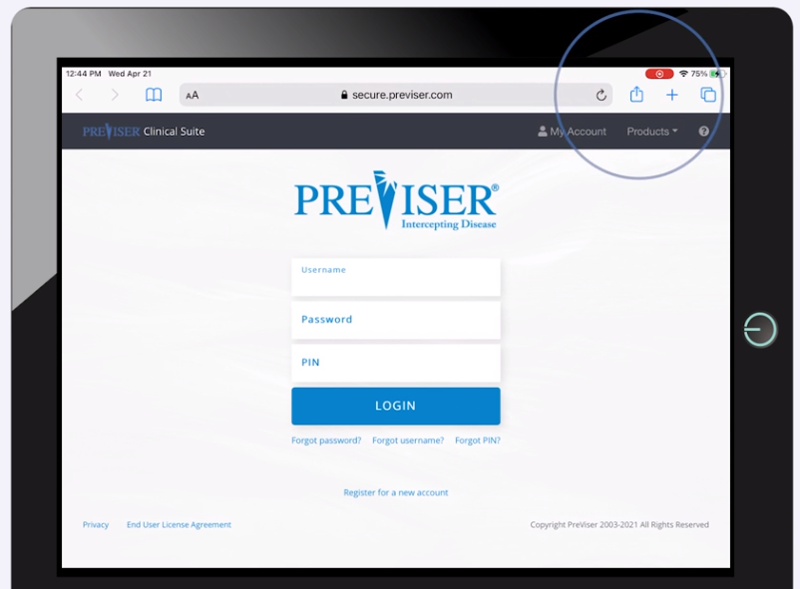
Click by click:
Tap the up arrow

Slide 37
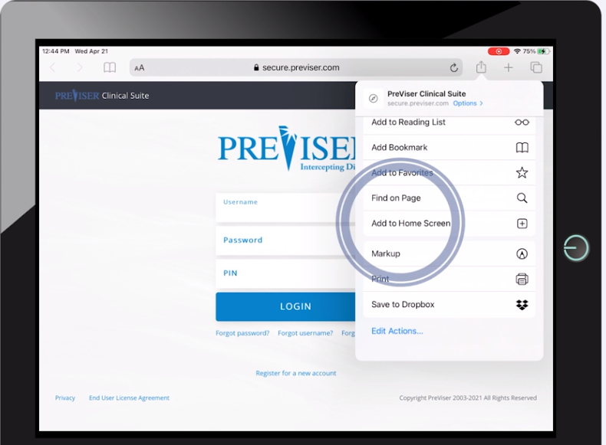
Click by click:
Select “Add to Home Screen”

Slide 38
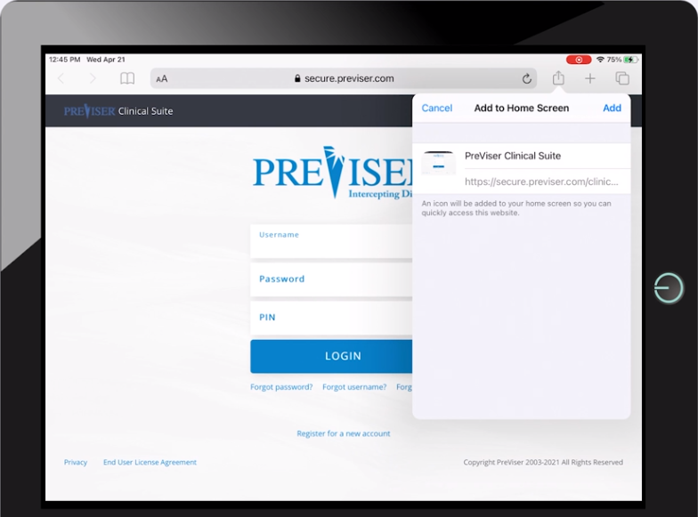
Click by click:
Enter in shortcut name and select “Add”

Slide 39

Click by click:
Test shortcut

Slide 40
Retrieve Username, Password and PIN

Slide 41
Overview
Click by click:
Reset Password Select Reset Password | Enter Email | Open Email | Click Here to Set Up a Permanent Password | Enter Password | Submit
Retrieve Username Select Retrieve Username | Enter Email | Open Email | Find Username | Log In
Retrieve PIN Select Retrieve PIN | Enter Email | Open Email | Find User & PIN |
  If User is Not On List Select MyAccount | Add User

Slide 42
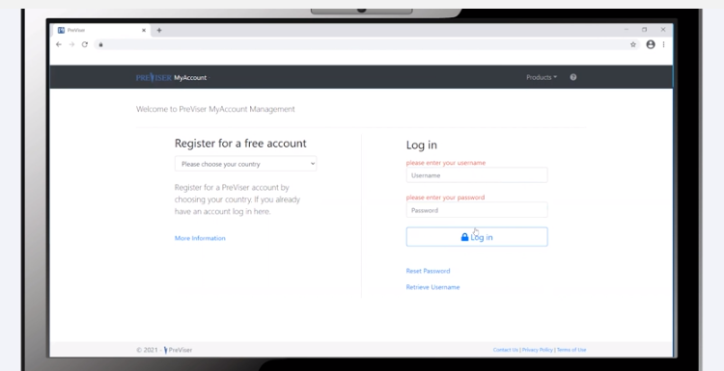
Click by click:
Select “Reset Password” or “Retrieve Username”

Slide 43
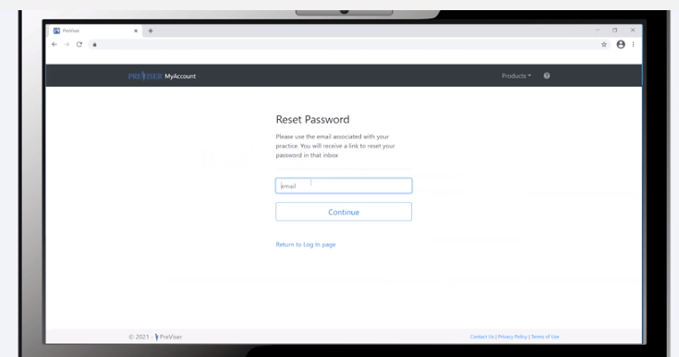
Click by click:
Enter in email and select “Continue”

Slide 44
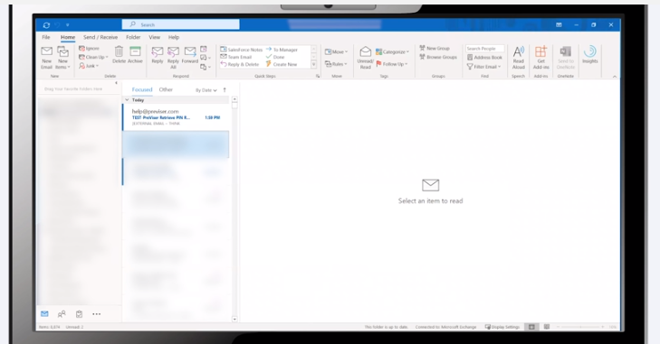
Click by click:
Open email from PreViser

Slide 45
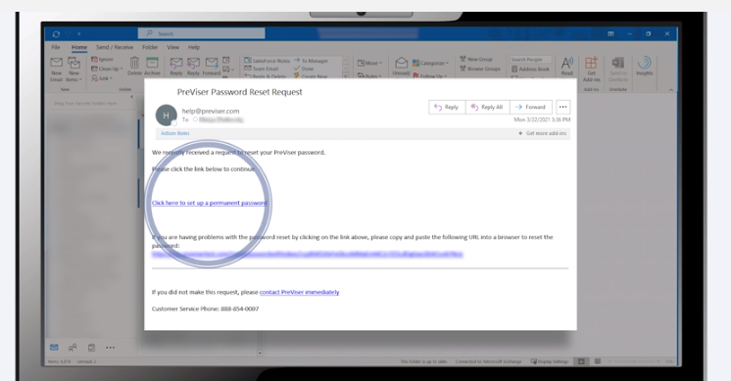
Click by click:
Select “Click here to set up a permanent password”

Slide 46
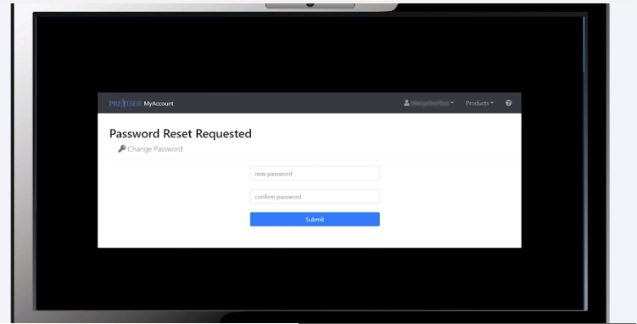
Click by click:
Enter in password and select “Submit”

Slide 47
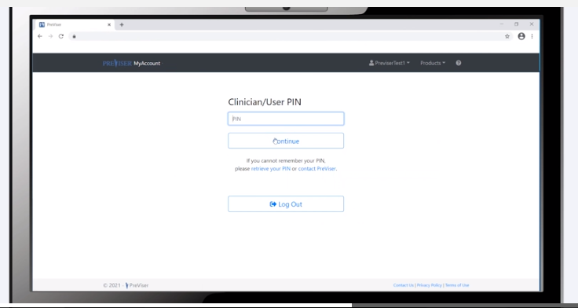
Click by click:
Select “Retrieve your PIN”

Slide 48
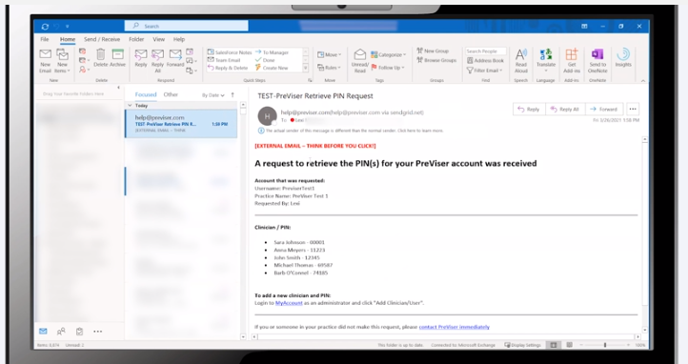
Click by click:
Open email from PreViser and find correct user and PIN

Slide 49
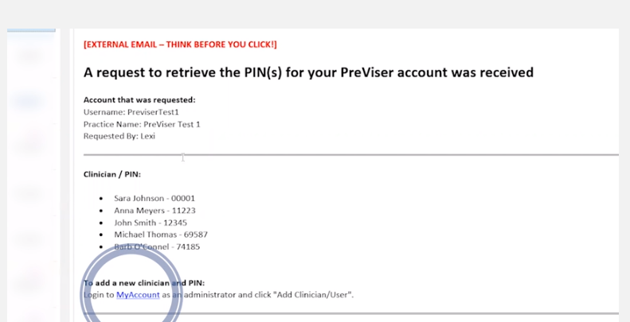
Click by click:
If you don’t see the user, select “MyAccount” and add user

Slide 50
Update Account Info

Slide 51
Overview
Click by click:
Edit Practice Information Select Edit Practice | Update Information | Save
Update Password Select Change Password | Enter Password | Save
Add Photo Select Browse | Select File | Save Image
Add Clinician Select Add Clinician/User | Enter in Required Fields | Add Clinician
Inactivate Clinician Select Clinician Name | Inactivate | Save Clinician
Reactivate Clinician Select Show Inactive | User Name | Uncheck Inactive | Save Clinician

Slide 52
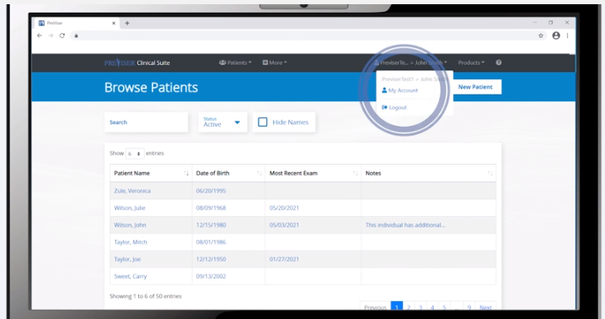
Click by click:
Select “MyAccount”

Slide 53
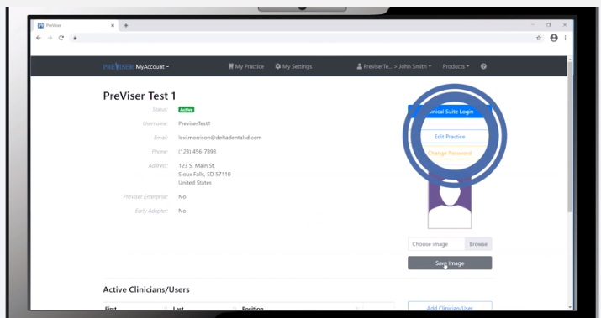
Click by click:
Select “Edit Practice” to update practice information

Slide 54
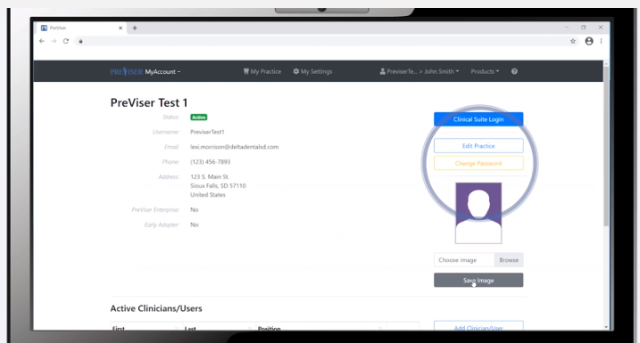
Click by click:
Select “Change Password” to update password

Slide 55
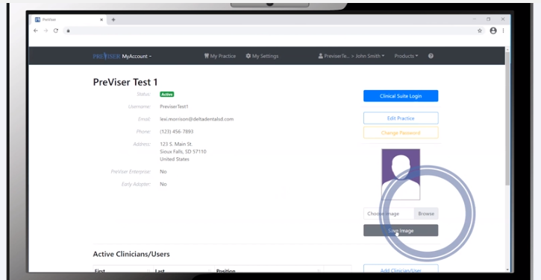
Click by click:
Select “Browse” to upload photo and select “Save Image”

Slide 56
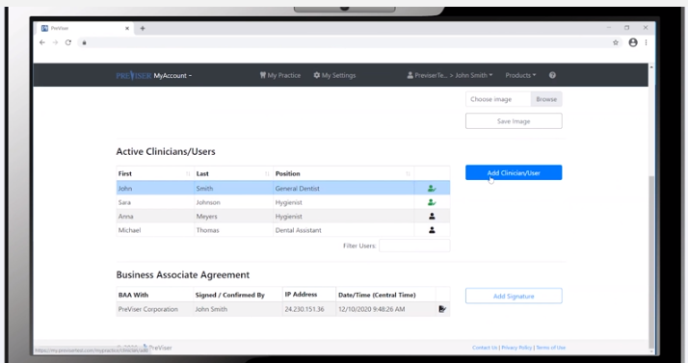
Click by click:
Select “Add Clinician/User”

Slide 57
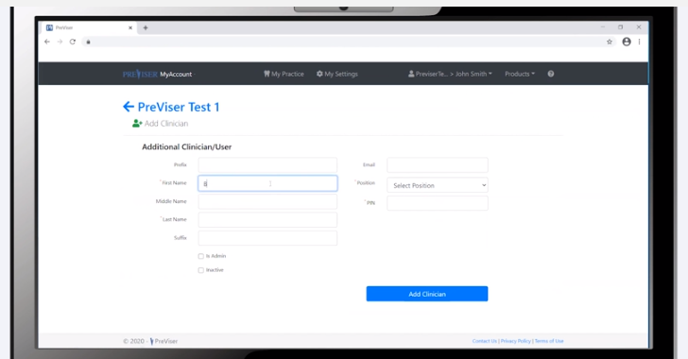
Click by click:
Enter in required information and select “Add Clinician”

Slide 58
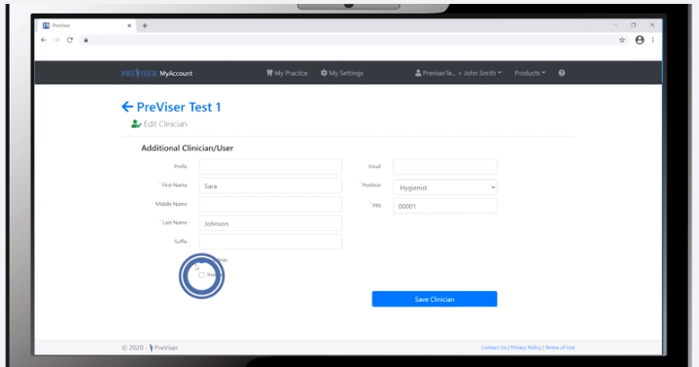
Click by click:
Select user and “Inactivate” and “Save Clinician” to inactivate user

Slide 59
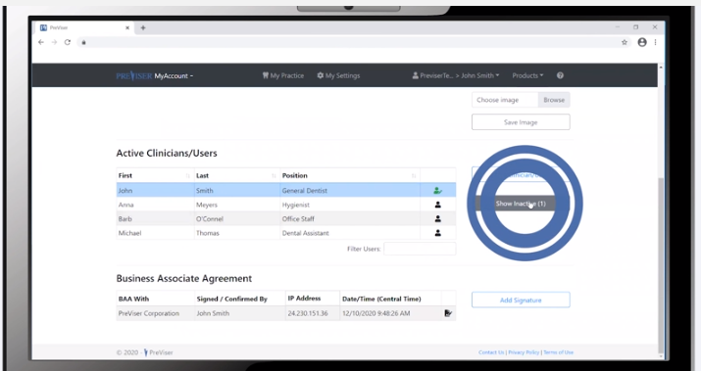
Click by click:
Select “Show Inactive”

Slide 60
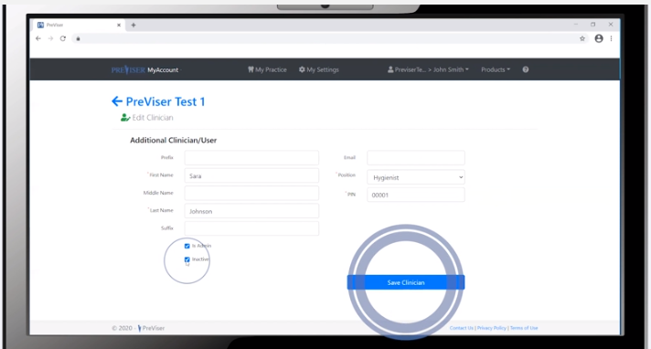
Click by click:
Uncheck “Inactive” and select “Save Clinician”

Slide 61


PreViser Corporation
T: 888-854-0007 | help@previser.com
© Copyright 2020 PreViser Corporation

