Slide 1


Enterprise Solutions

Slide 2
Import Patients from your Practice Management System

Slide 3
Overview
Click by click:
Import Patients from your Practice Management System Import Patients | Start New Import | Next | Browse | Select Desired File | Indicate if File Contains Header Row | Next | Next | Fill Out Contact Details | Submit | Repeat Process if Necessary

Slide 4
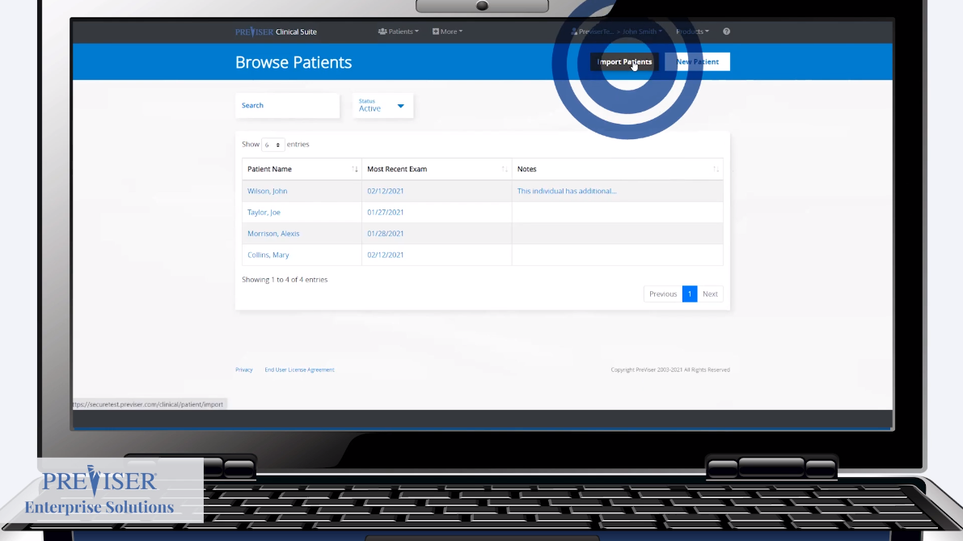
Click by click:
Select “Import Patients”

Slide 5
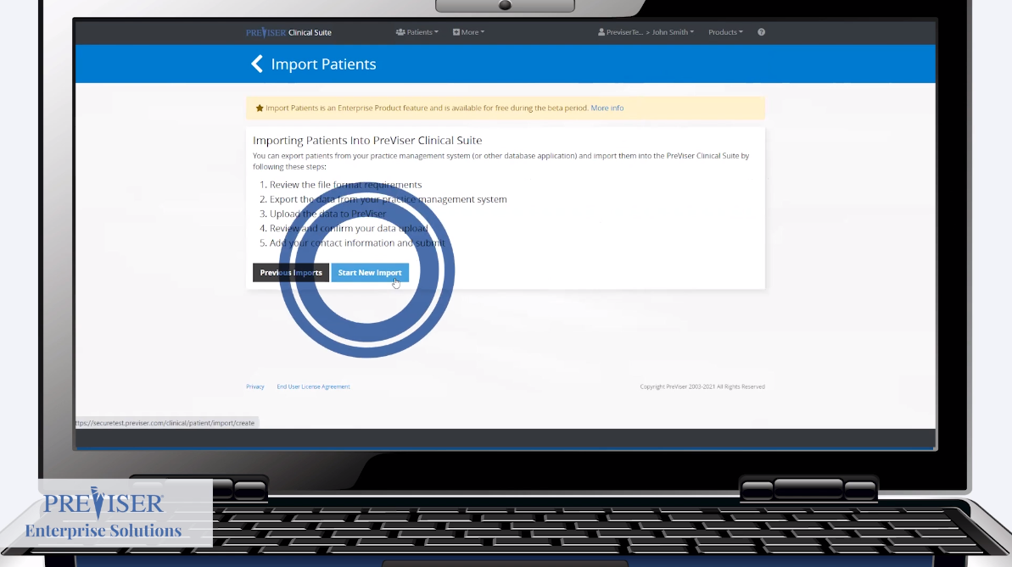
Click by click:
Select “Start New Import”

Slide 6
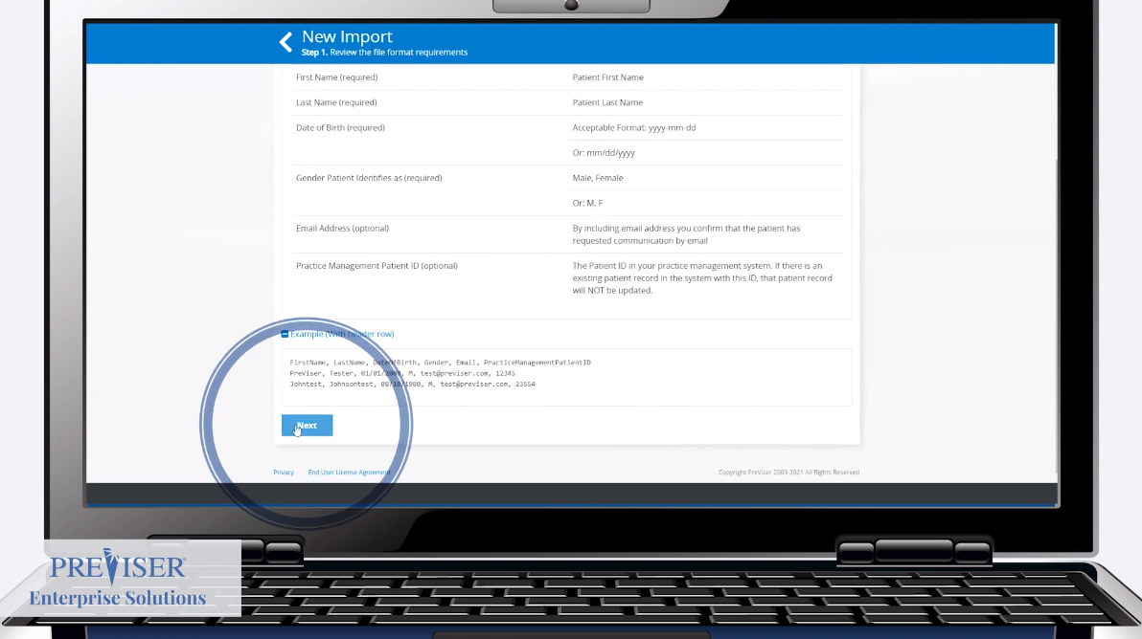
Click by click:
Select “Next”

Slide 7
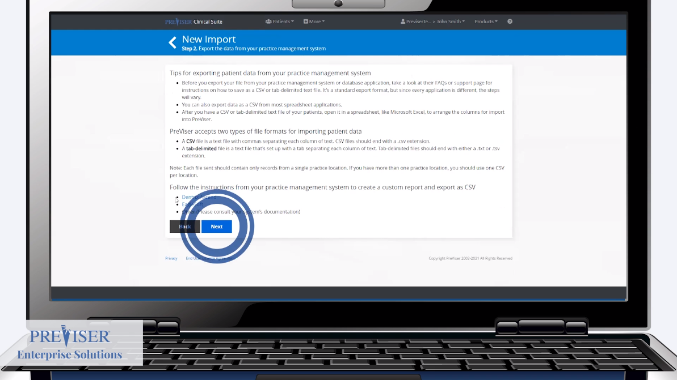
Click by click:
Select “Next”

Slide 8
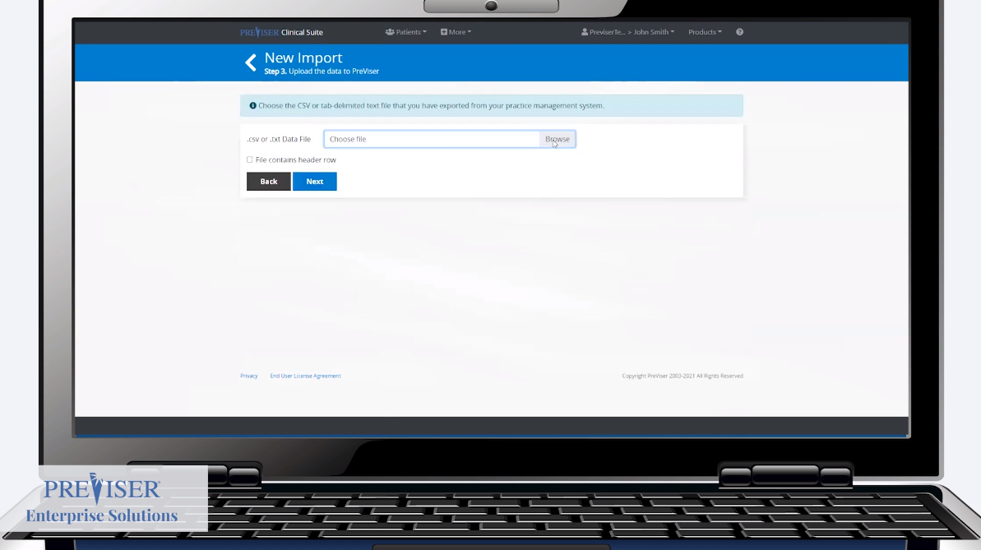
Click by click:
Select “Browse”

Slide 9
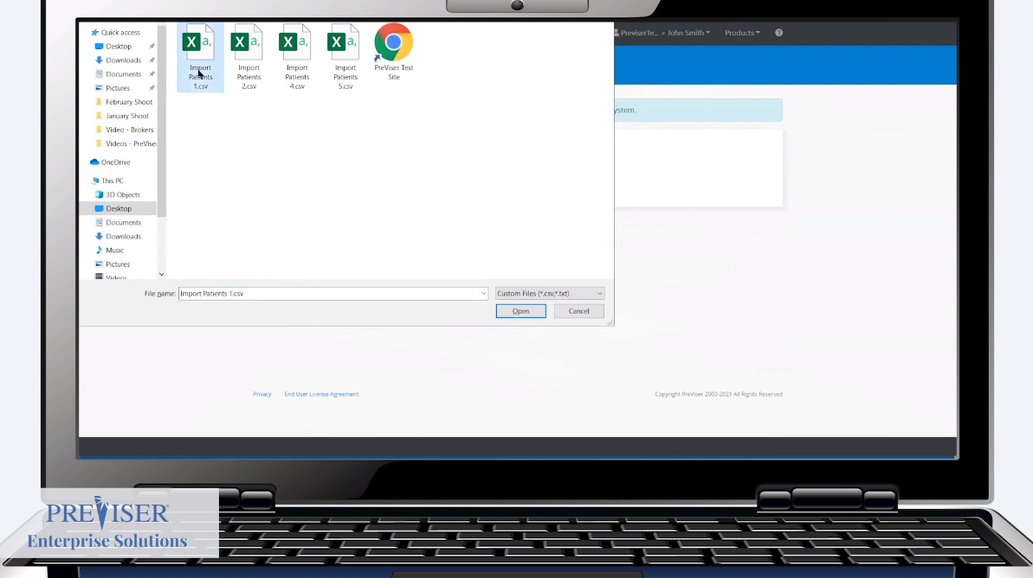
Click by click:
Select desired file

Slide 10
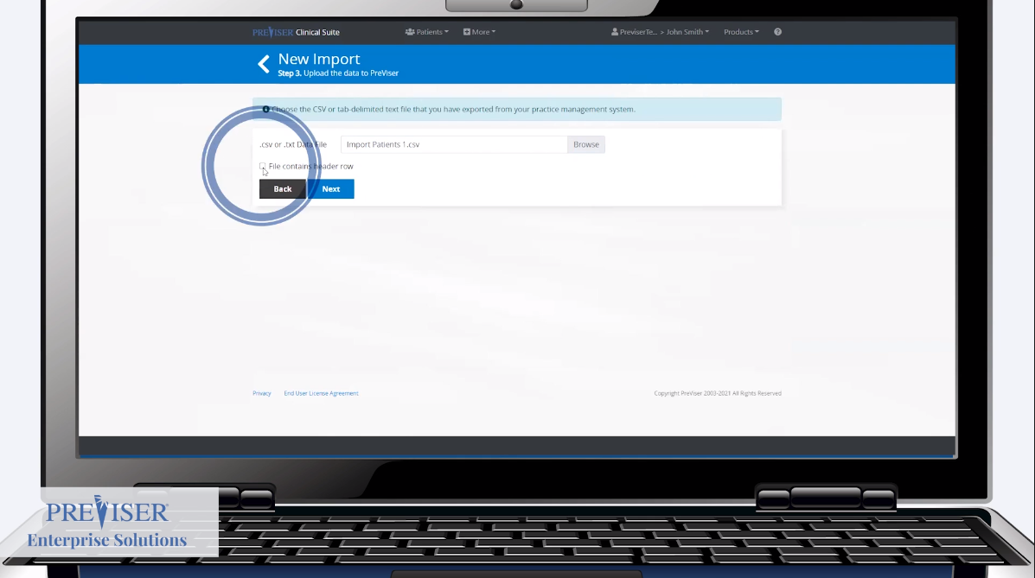
Click by click:
Select “File contains a header row” if applicable

Slide 11
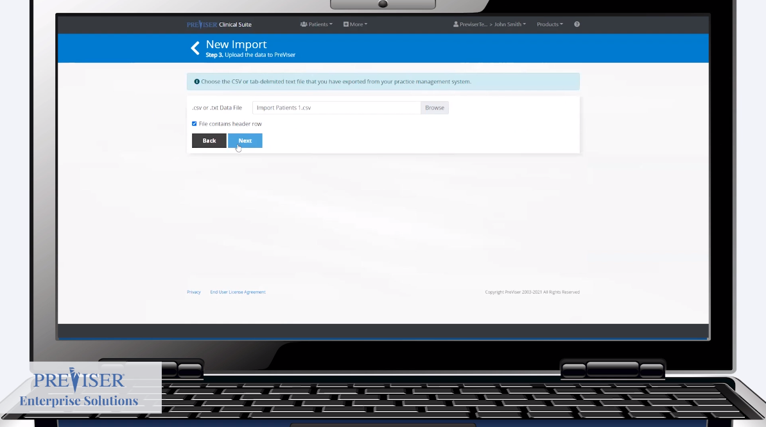
Click by click:
Select “Next”

Slide 12
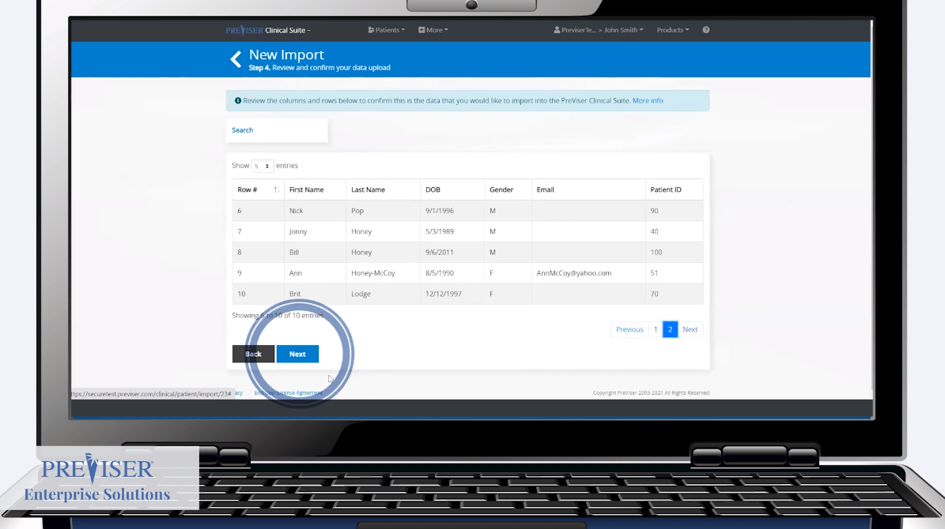
Click by click:
Select “Next”

Slide 13
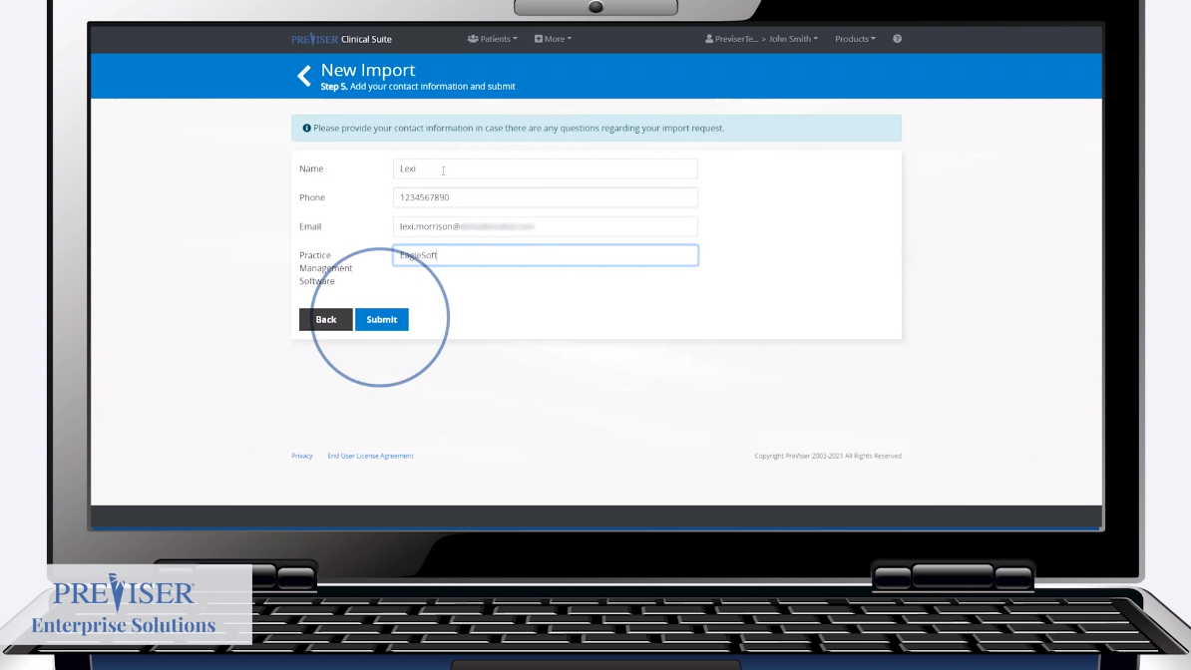
Click by click:
Fill out contact information and select “Submit

Slide 14
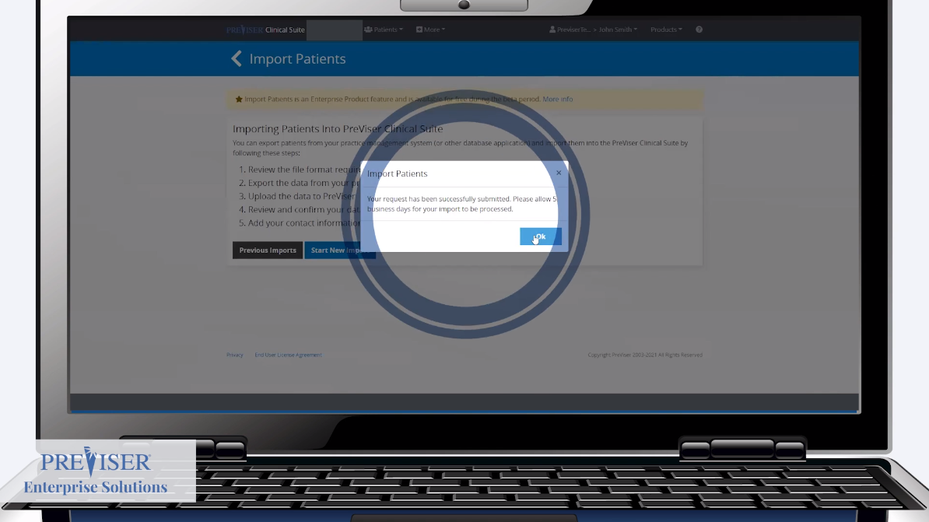
Click by click:
Select “Ok”

Slide 15
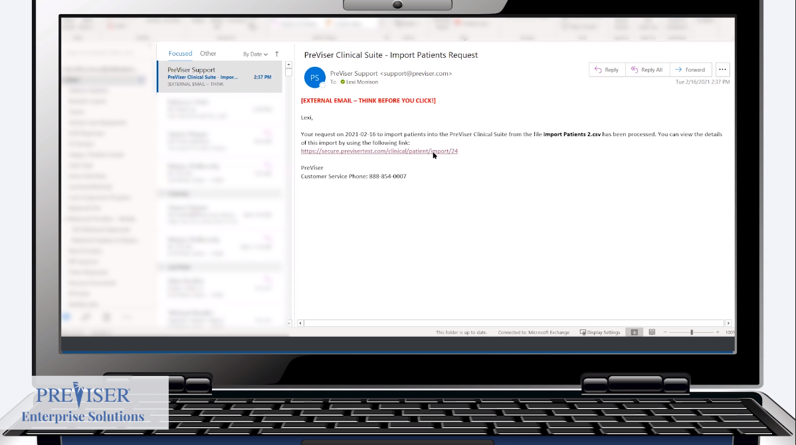
Click by click:
After PreViser processes your import, open email and select the link

Slide 16
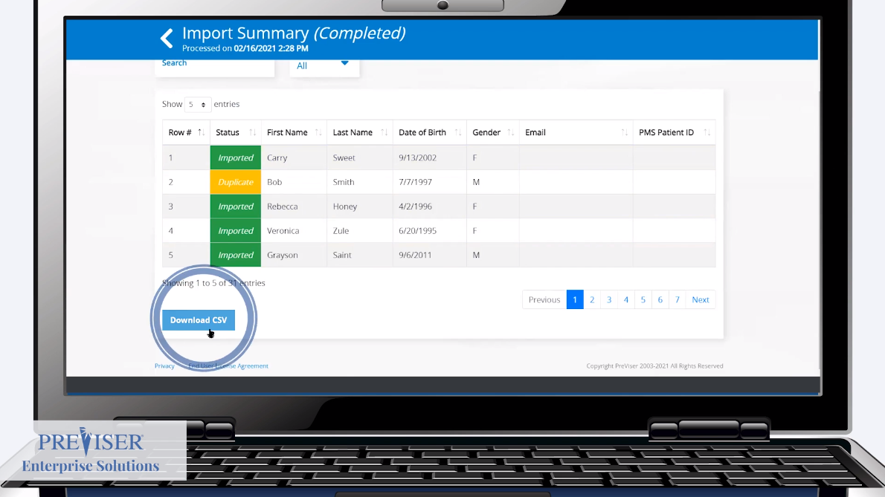
Click by click:
Evaluate file and if any “Duplicate” or “Invalid” records appear select “Download CSV”

Slide 17
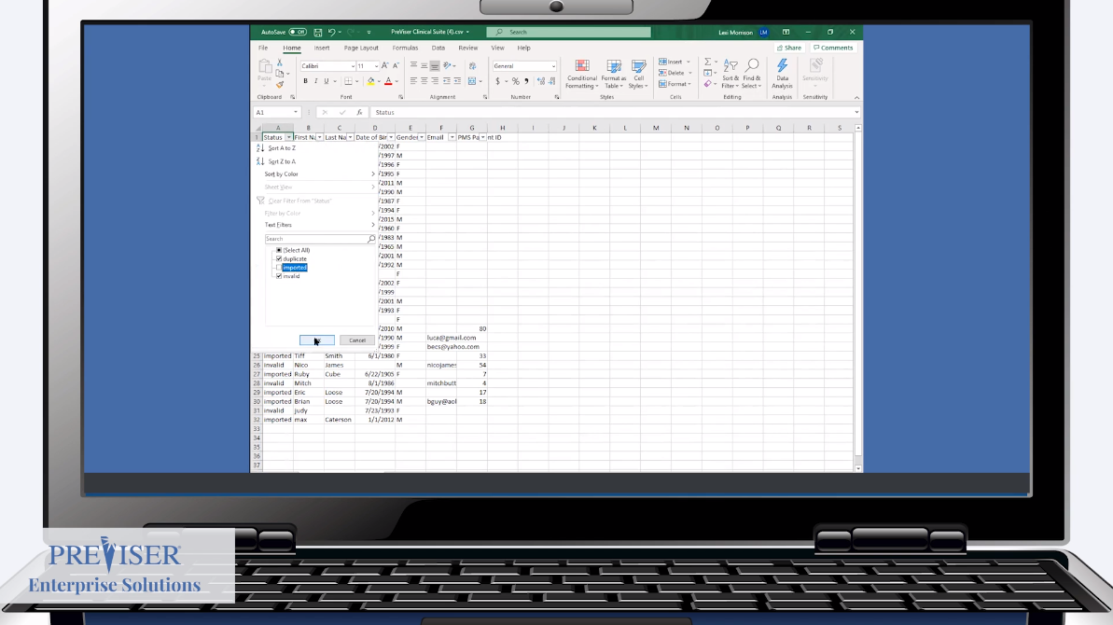
Click by click:
Filter out “Imported” records

Slide 18
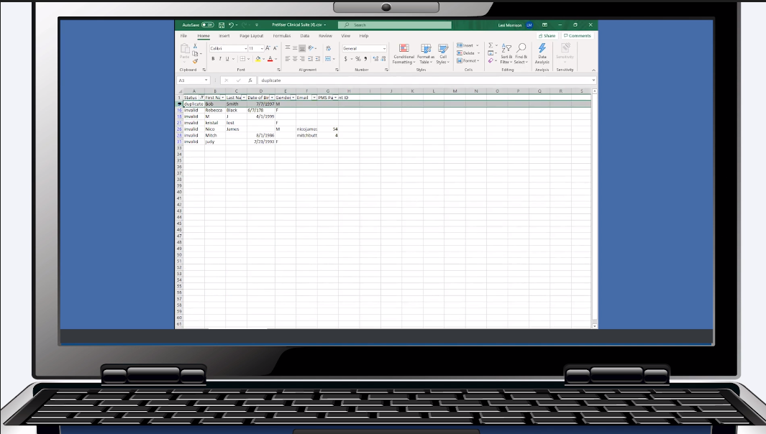
Click by click:
Update records

Slide 19
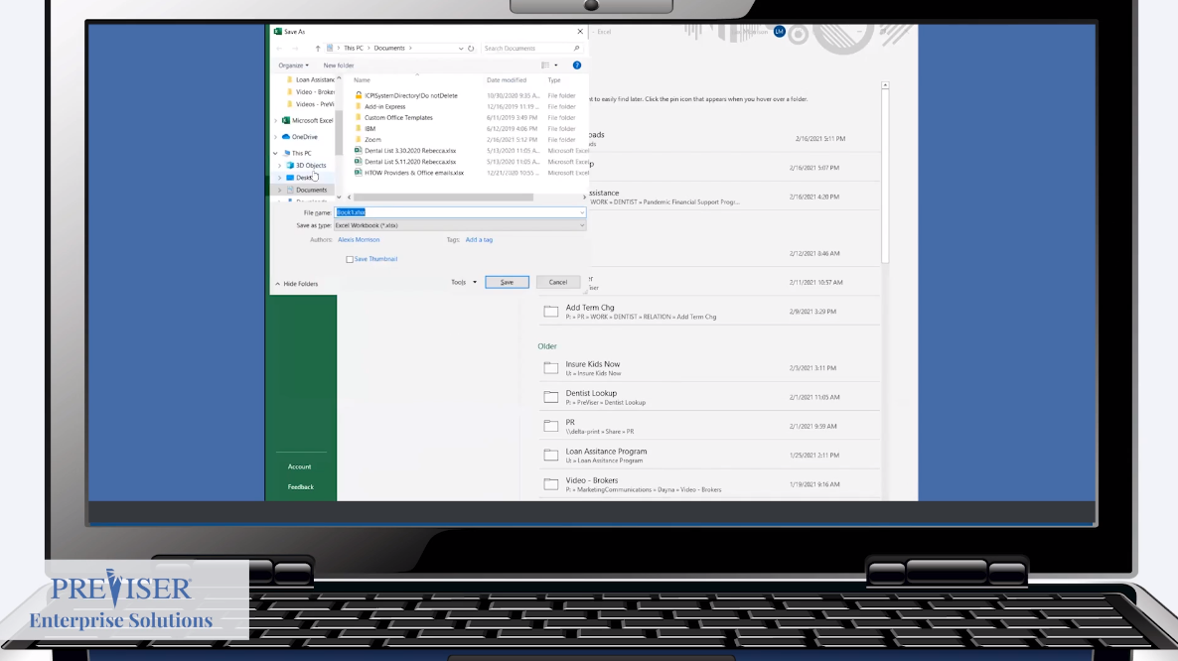
Click by click:
Save the new file

Slide 20
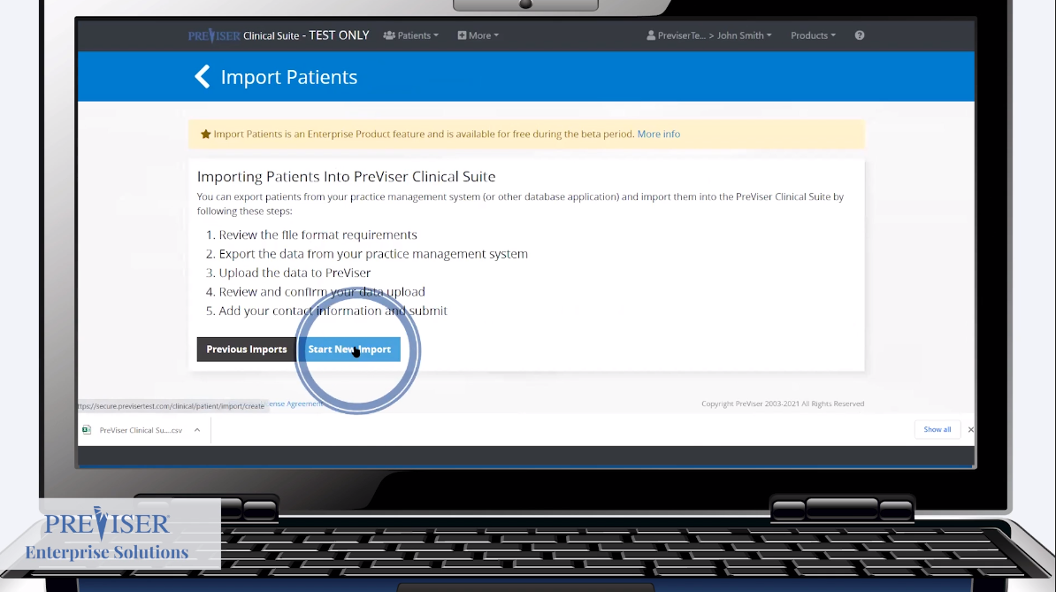
Click by click:
Select “Start New Import”

Slide 21
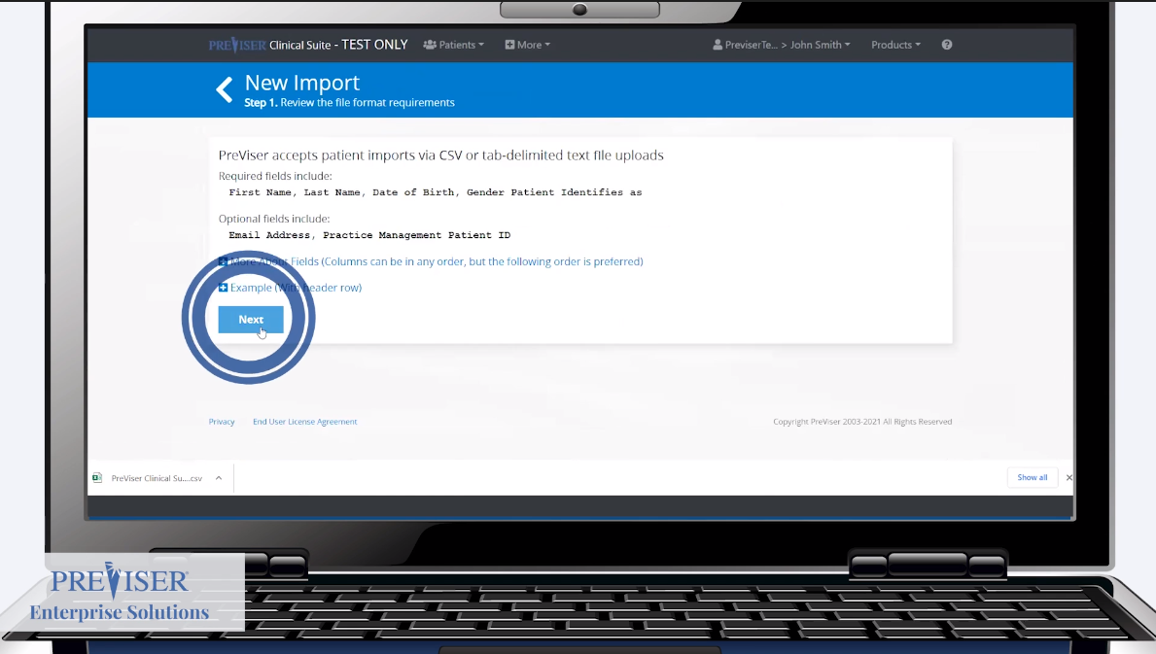
Click by click:
Select “Next"

Slide 22
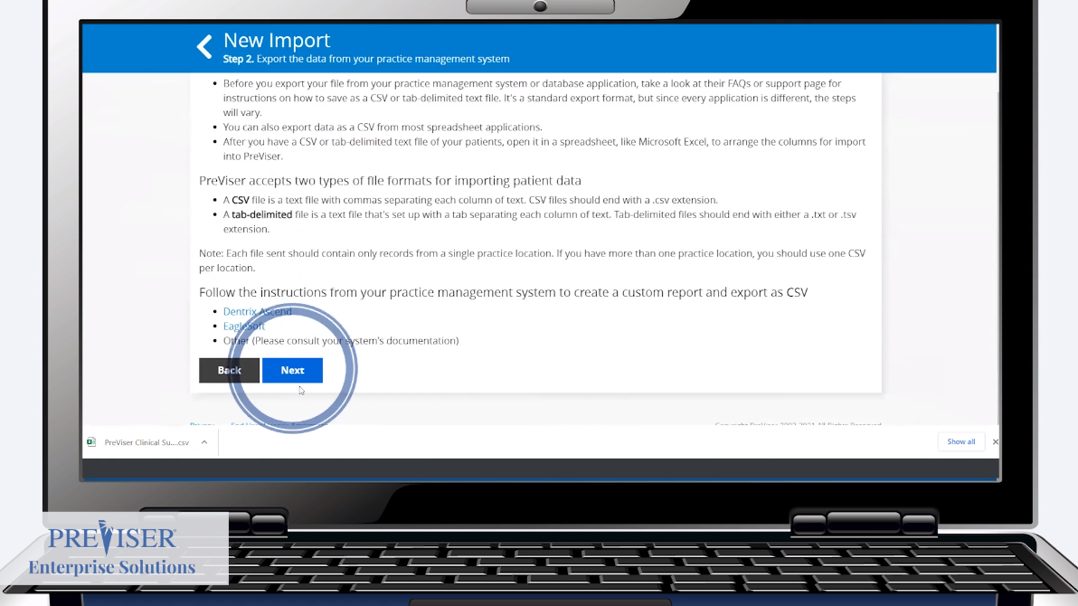
Click by click:
Select “Next"

Slide 23
Click by click:
Select “Browse”

Slide 24
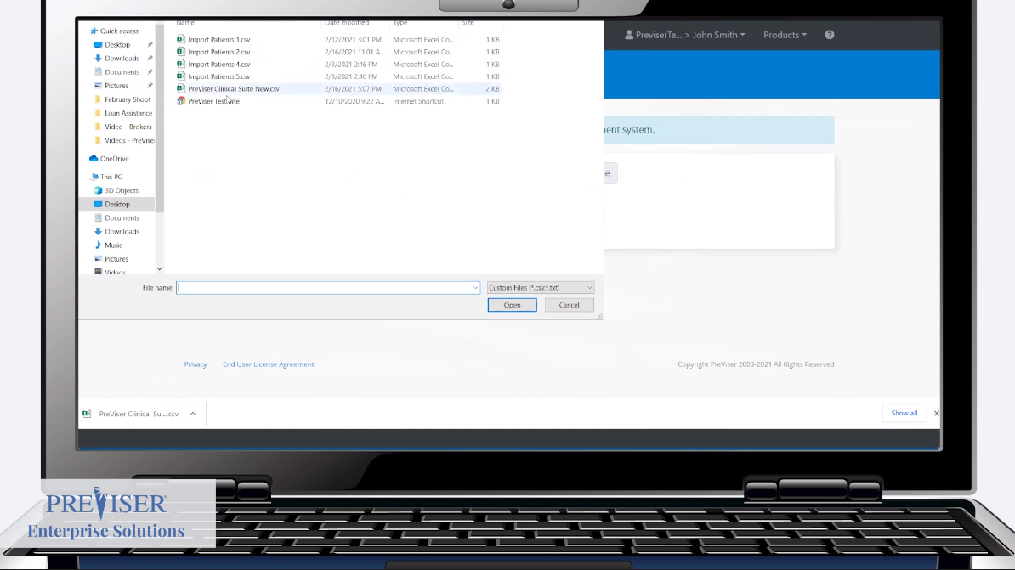
Click by click:
Select desired file

Slide 25
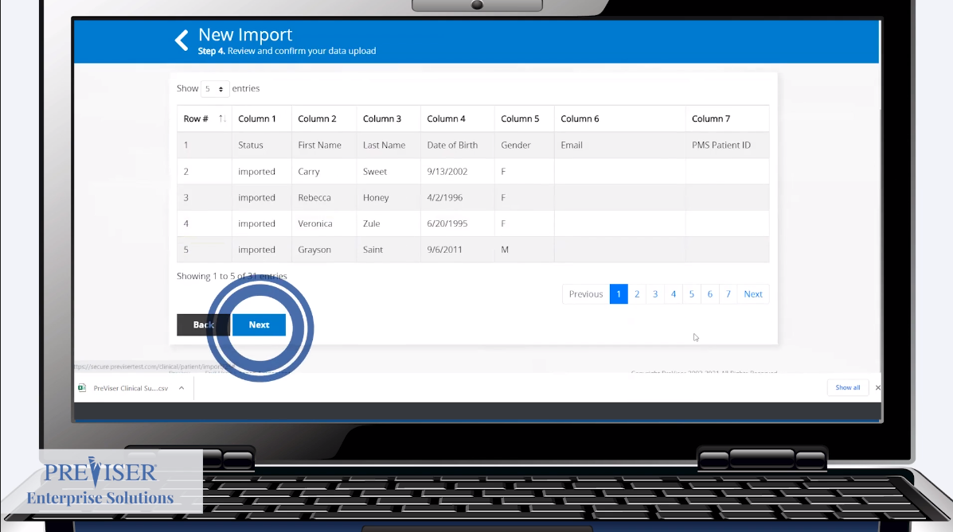
Click by click:
Select “Next"

Slide 26
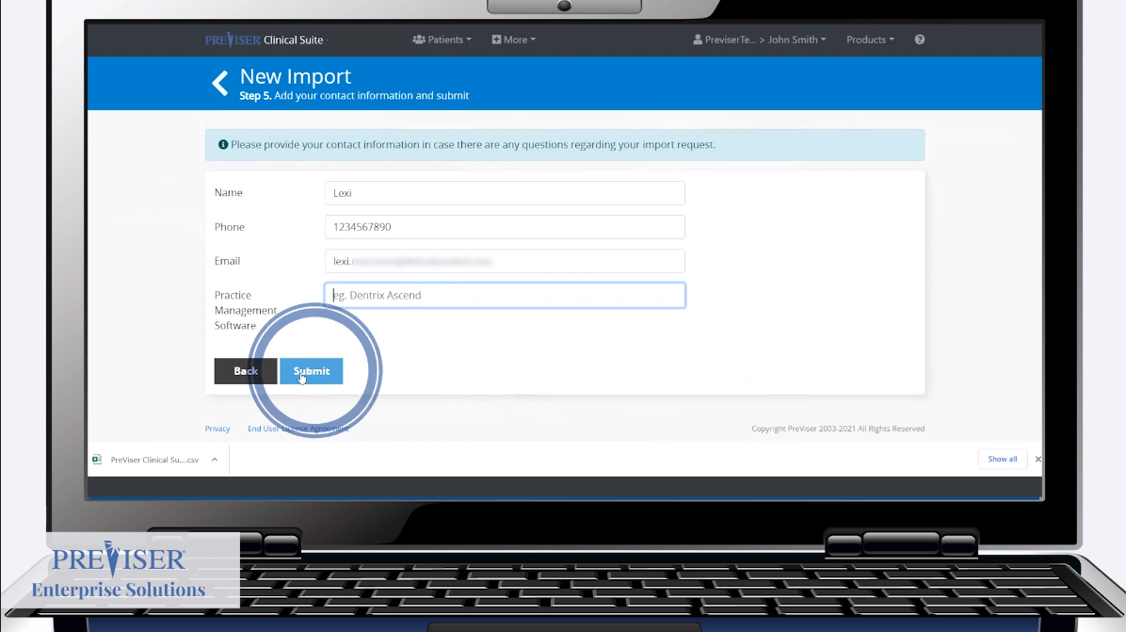
Click by click:
Fill out contact information and select “Submit”

Slide 27
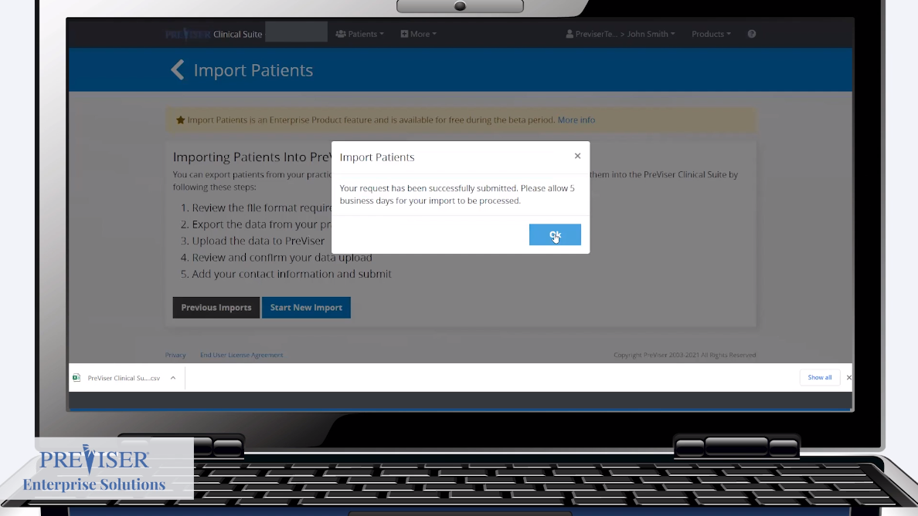
Click by click:
Select “Ok” and evaluate email. Repeat process if necessary

Slide 28
Report Customization for an Individual Report

Slide 29
Overview
Click by click:
Report Customization for an Individual Report Patient Name | Assessment - Complete Assessment | Submit | Edit | Customize | Customize Desired Fields | Save | Done
  If you wish to restore to original text select Reset to Default | Save | Done

Slide 30
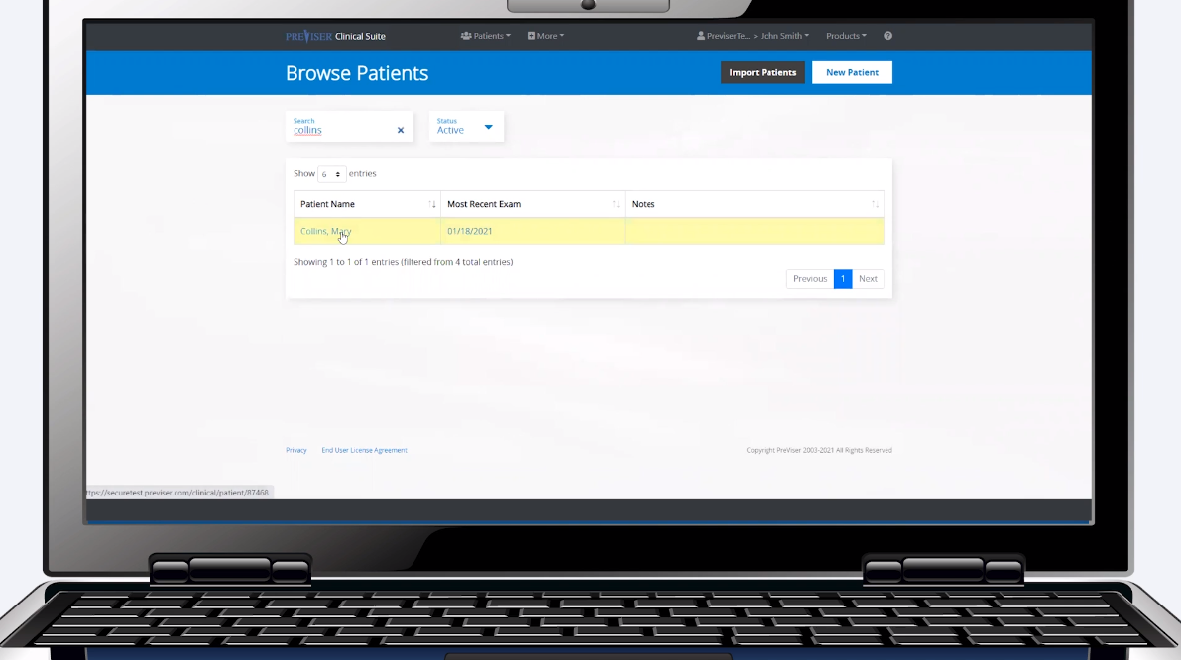
Click by click:
Select patient name

Slide 31
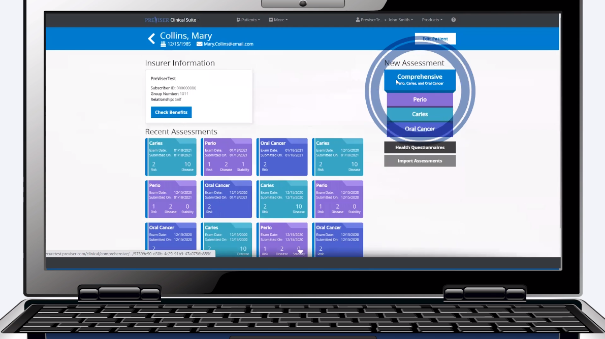
Click by click:
Select desired assessment

Slide 32
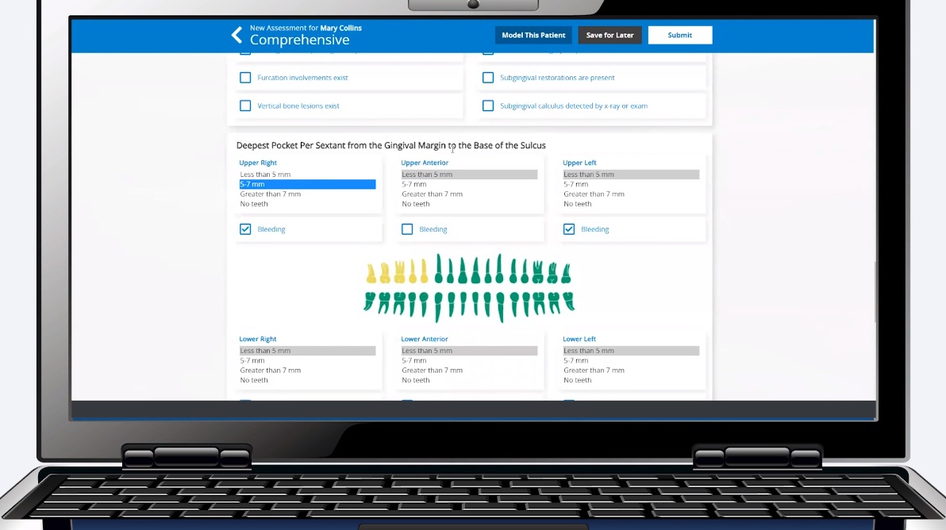
Click by click:
Fill out assessment

Slide 33
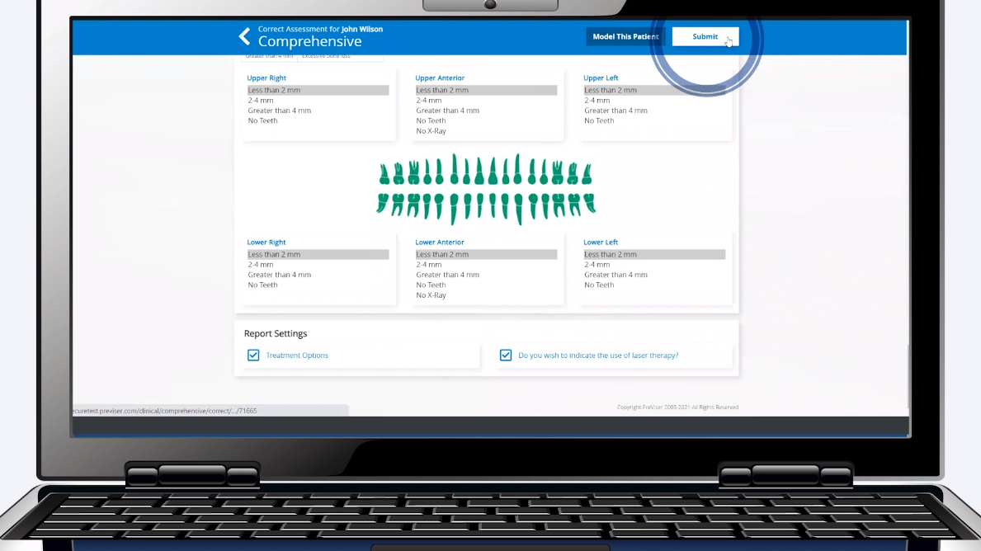
Click by click:
Select “Submit”

Slide 34
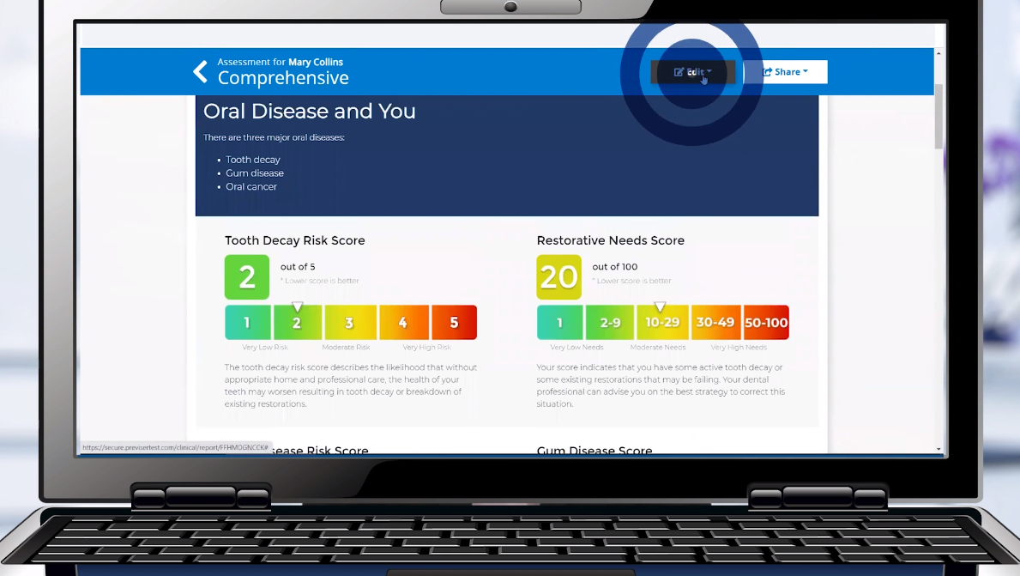
Click by click:
Select “Edit”

Slide 35
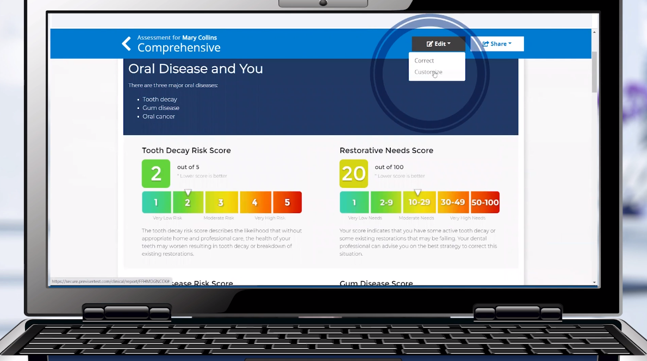
Click by click:
Select “Customize”

Slide 36
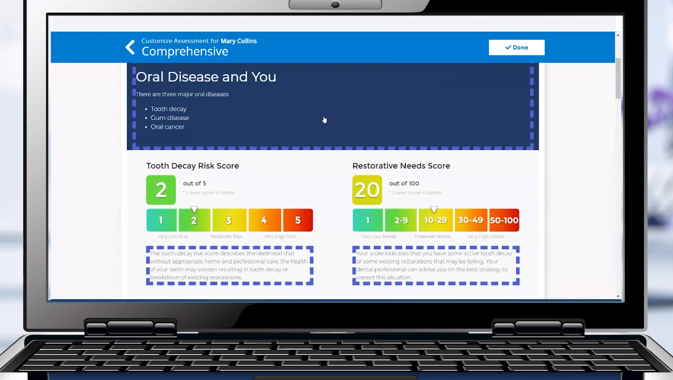
Click by click:
Select purple dotted area you wish to customize

Slide 37
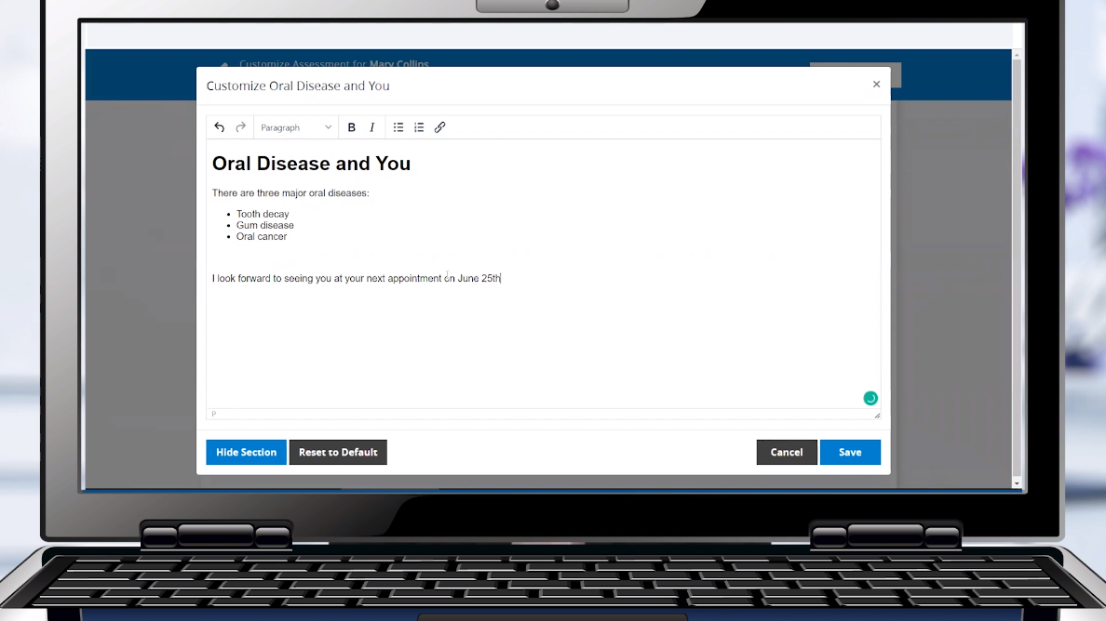
Click by click:
Enter in customizations

Slide 38
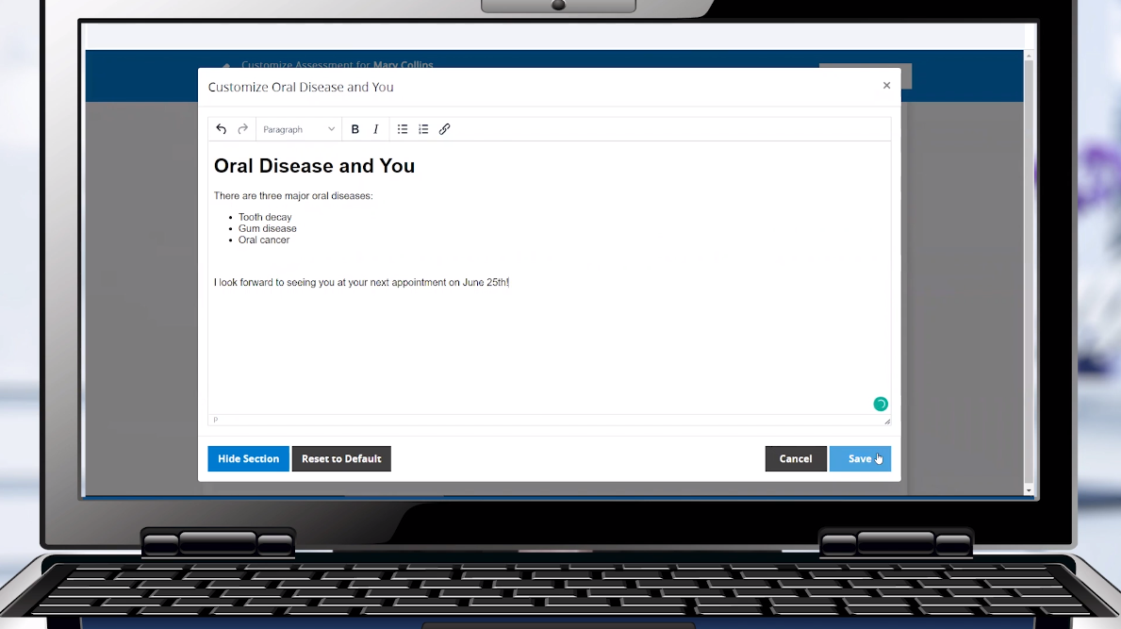
Click by click:
Select “Save”

Slide 39
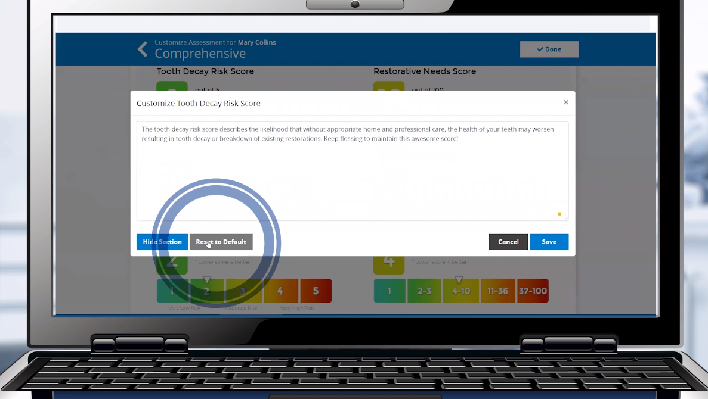
Click by click:
If you wish to restore to the original text select “Reset to Default”

Slide 40
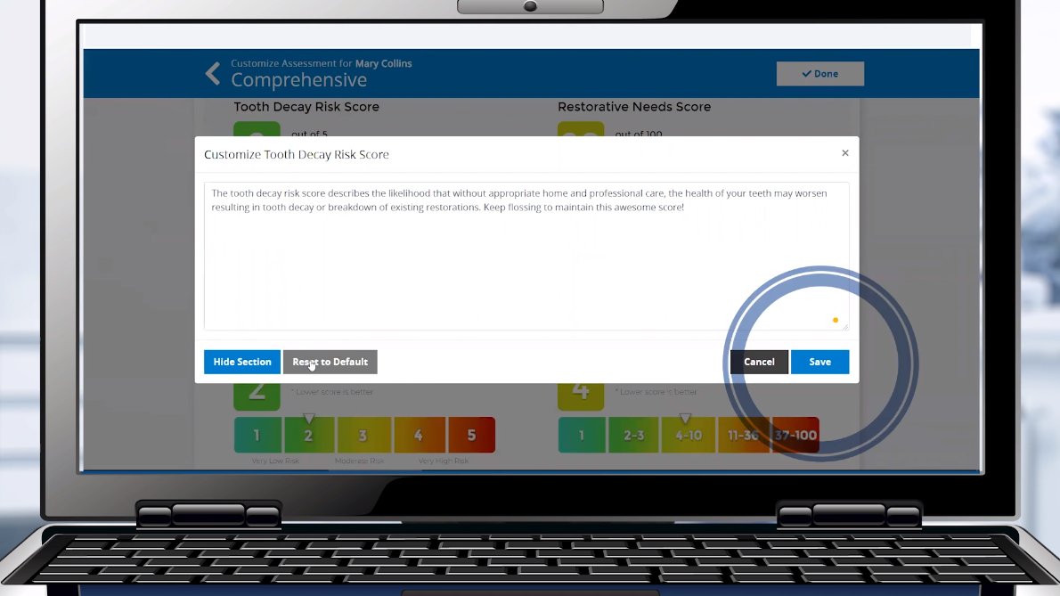
Click by click:
Select “Save"

Slide 41
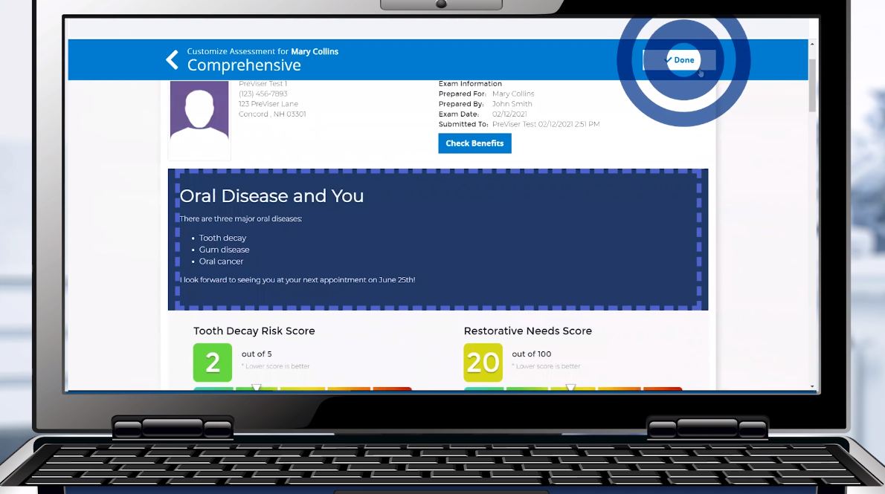
Click by click:
Select “Done"

Slide 42
Report Customization for Whole Practice

Slide 43
Overview
Click by click:
Report Customization for a Whole Practice More | Settings | Assessment Defaults | Select Desired Assessment | Update Text | Save
  If you wish to restore to original text select Reset to Default | Save
  Update Practice Information Select Name in Top Corner | My Account | Edit Practice | Update Information | Save
  Add Business Photo Select Browse | Select Image | Save Image

Slide 44
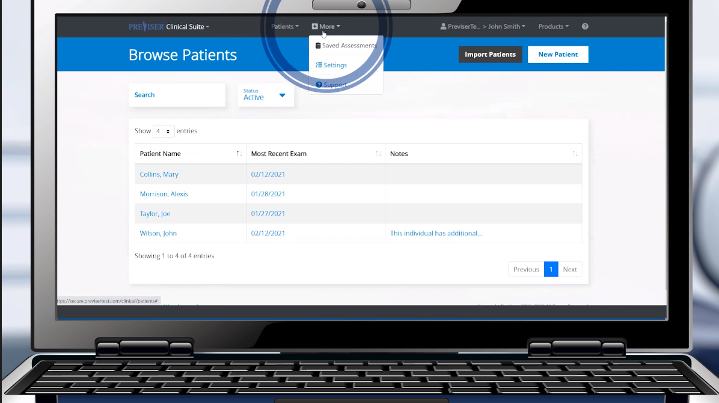
Click by click:
Select “More”

Slide 45
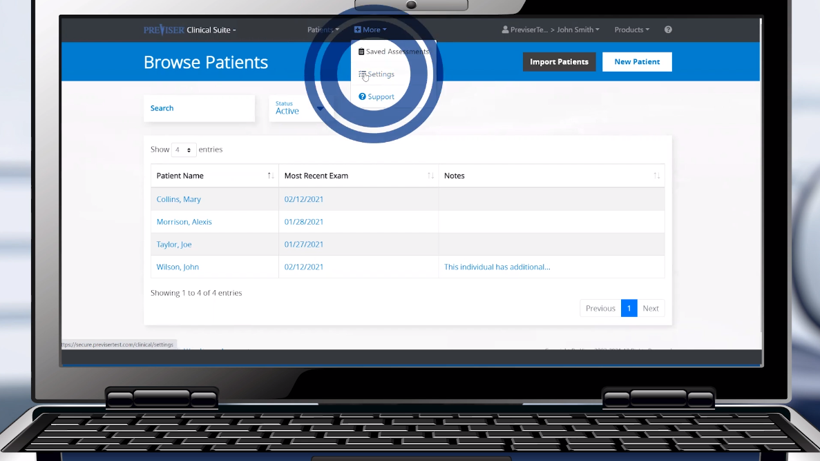
Click by click:
Select “Settings”

Slide 46
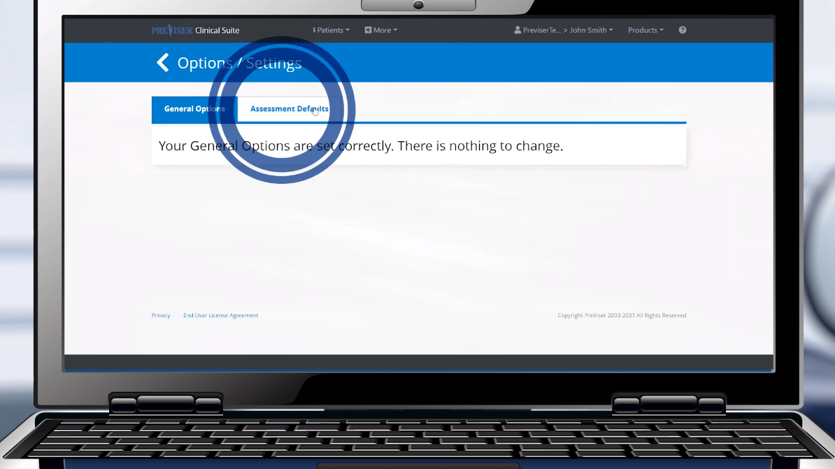
Click by click:
Select “Assessment Defaults”

Slide 47
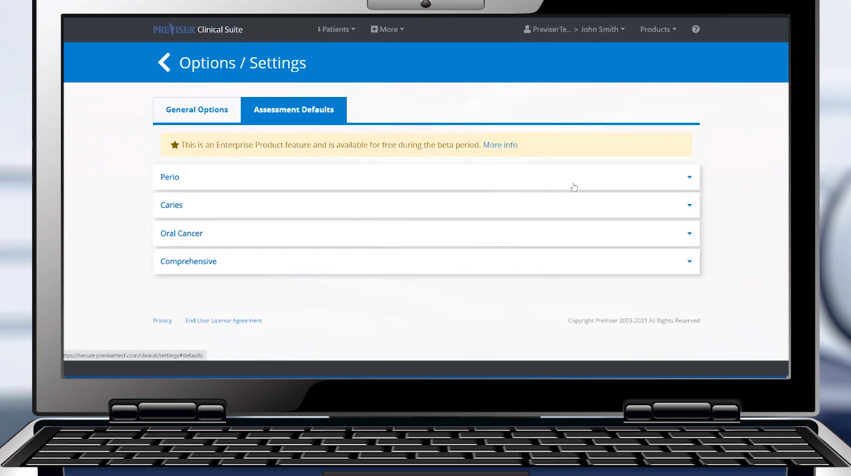
Click by click:
Select desired assessment

Slide 48
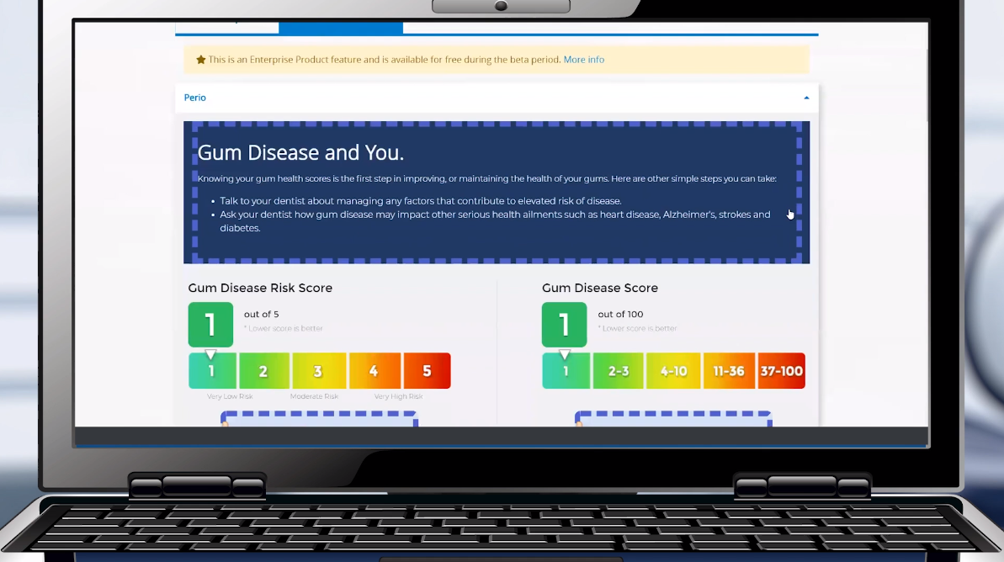
Click by click:
Select purple dotted are you wish to update

Slide 49
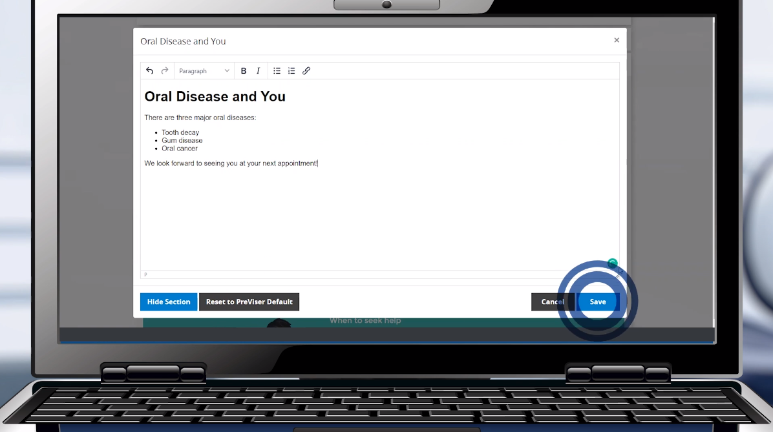
Click by click:
Add customized text and select “Save”

Slide 50
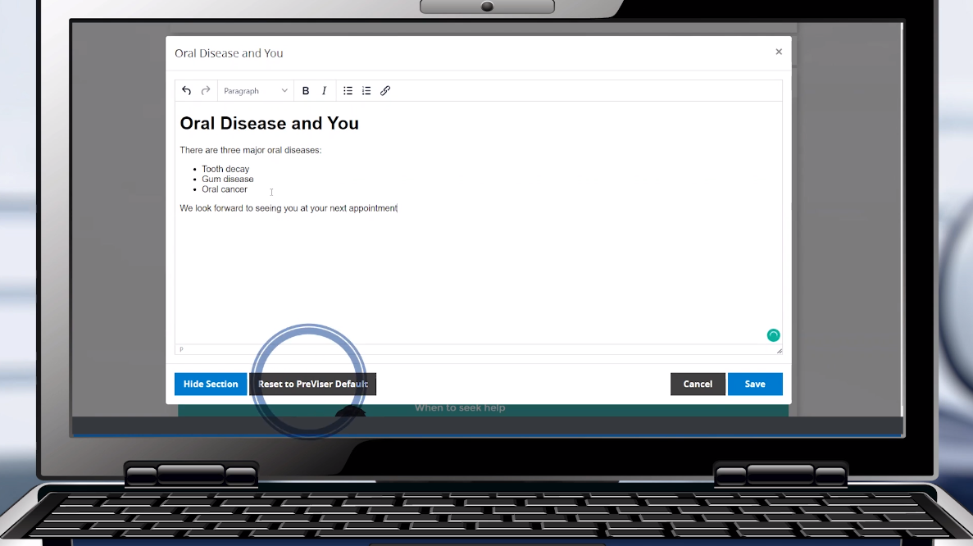
Click by click:
Select “Reset to PreViser Default” if necessary

Slide 51
Click by click:
Select “Save”

Slide 52
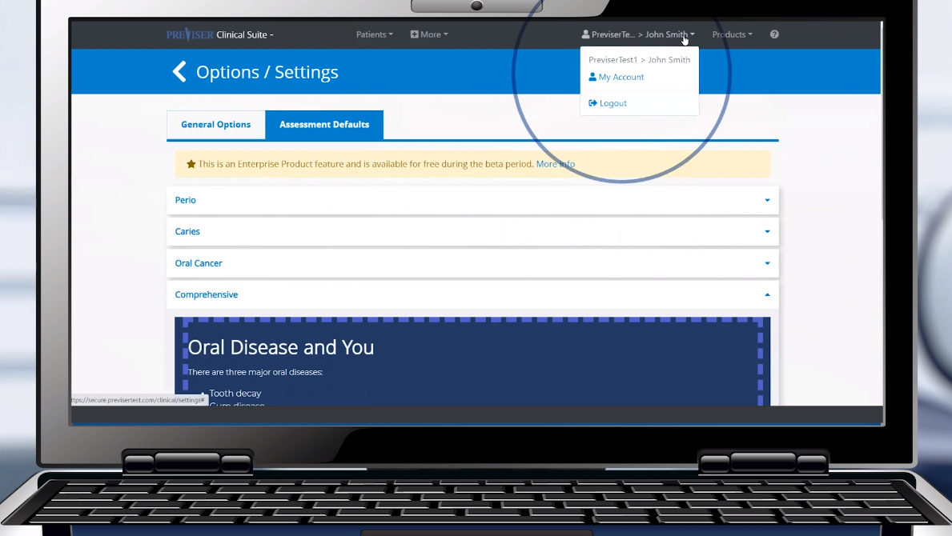
Click by click:
Select name in top right corner and “My Account”

Slide 53
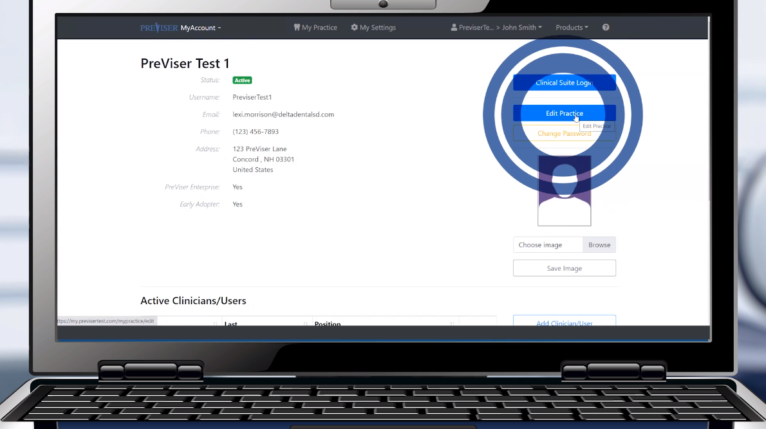
Click by click:
Select “Edit Practice”

Slide 54
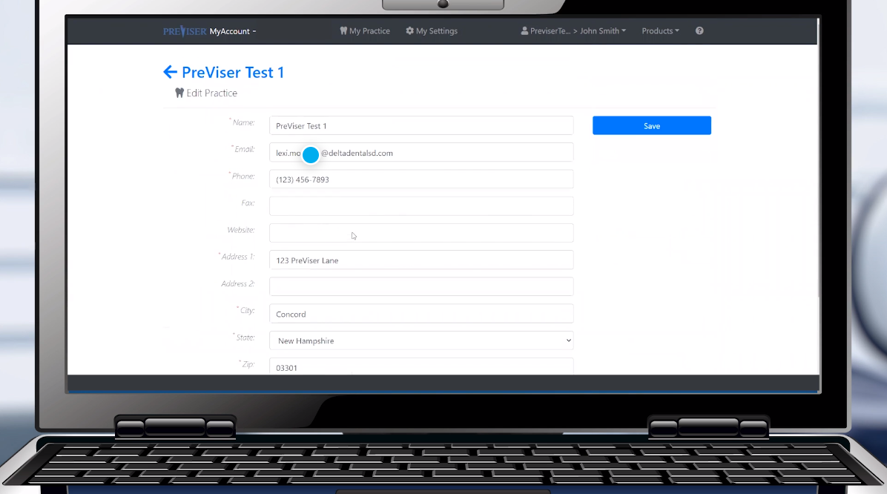
Click by click:
Update information and select “Save”

Slide 55
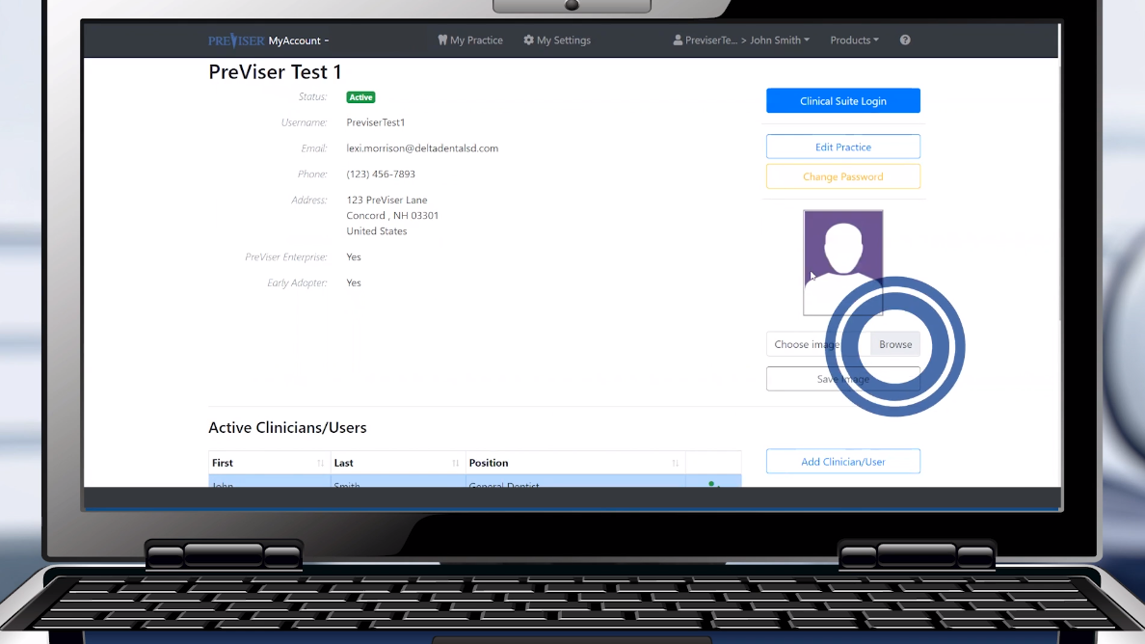
Click by click:
Select “Browse"

Slide 56
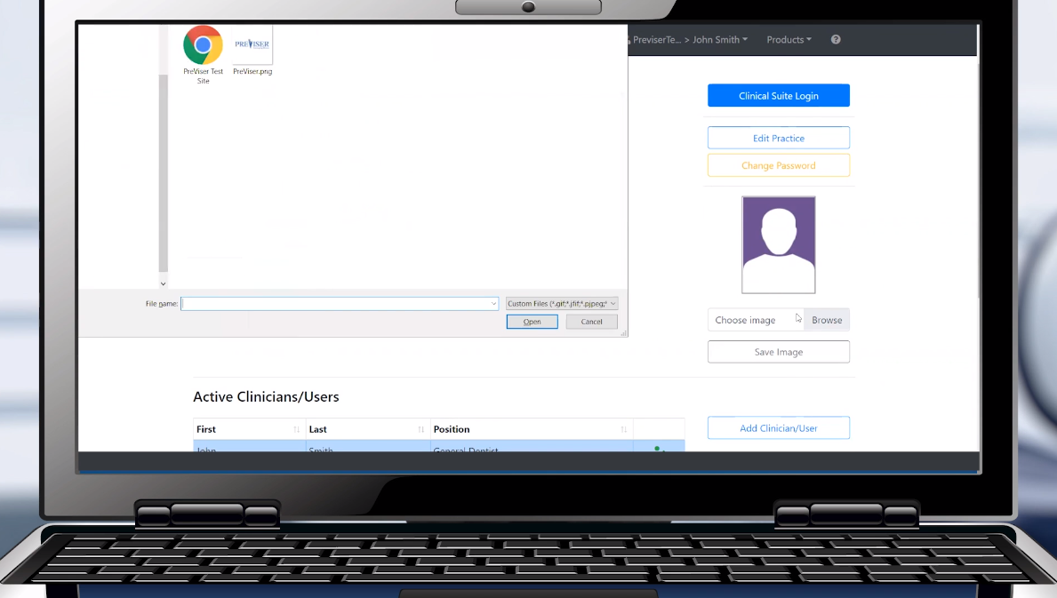
Click by click:
Select desired image

Slide 57
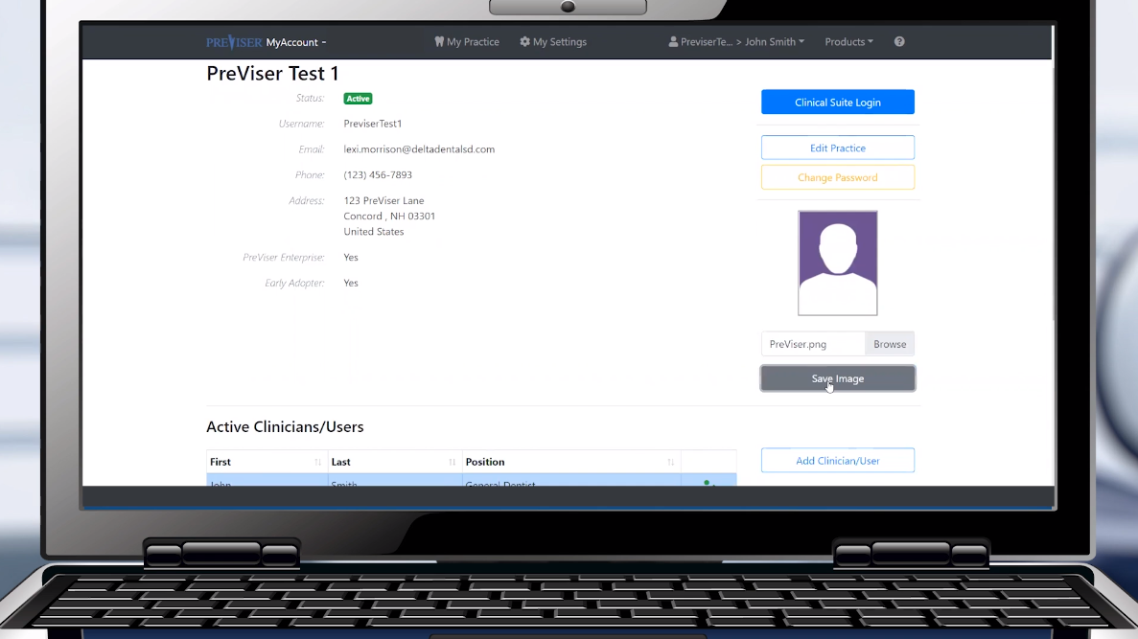
Click by click:
Select “Save Image”

Slide 58
PreViser Analytics

Slide 59
Overview
Click by click:
PreViser Analytics Products | PreViser Analytics | Filter | Export

Slide 60
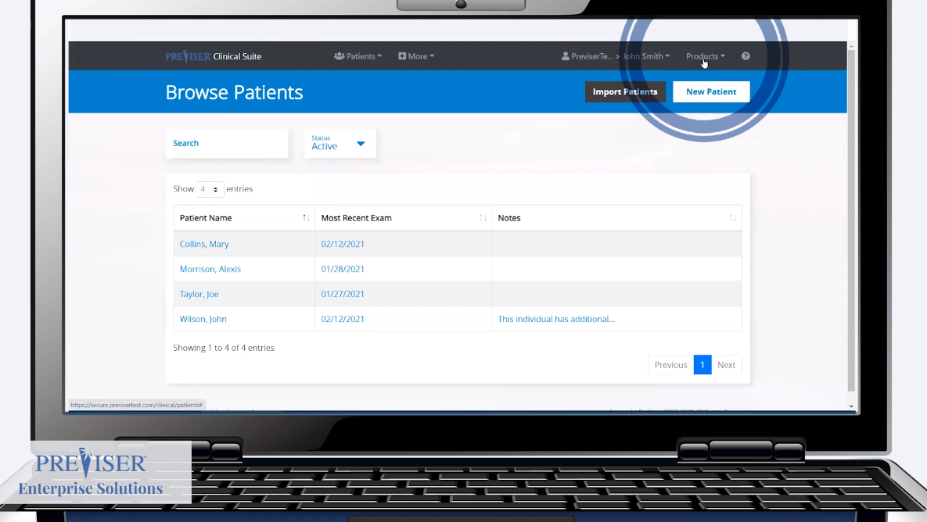
Click by click:
Select “Products”

Slide 61
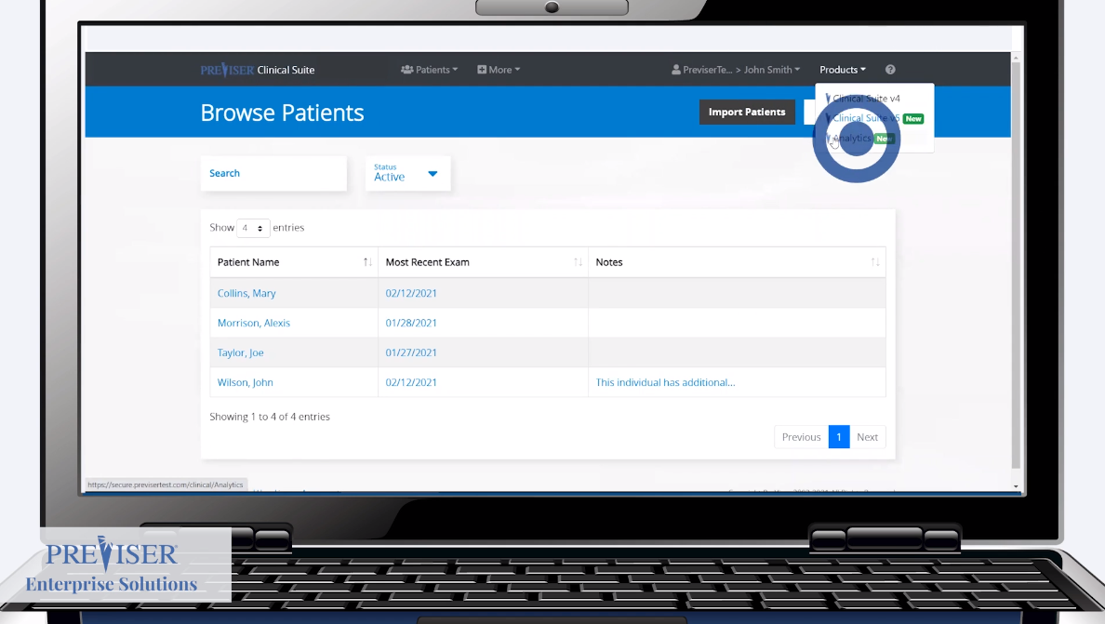
Click by click:
Select “PreViser Analytics”

Slide 62

Click by click:
Filter by usage types

Slide 63

Click by click:
Filter by assessment type

Slide 64

Click by click:
Filter by additional features

Slide 65

Click by click:
Select “Export” to compare to claims data

Slide 66


PreViser Corporation
T: 888-854-0007 | help@previser.com
© Copyright 2020 PreViser Corporation

