Slide 1


PreViser Clinical Suite

Slide 2
Add/Edit Patients

Slide 3
Overview
Click by click:
Add Patient (No insurance or not listed) New Patient | First Name | Last Name | Gender | Date of Birth | Insurer Information | None/Other | Save Patient
Add Patient (Insurance listed) New Patient | First Name | Last Name | Gender | Date of Birth | Insurer Information | "Select insurance Company | Subscriber ID | Enter any Additional Info Indicated by * | Save Patient
Edit Patient Select Patient Name | Edit Patient | Update Demographic Information and/or Insurance Information | Save Patient
Inactive Patient Select Patient Name | Select “No” next to "Is Patient Active" | Save Patient

Slide 4
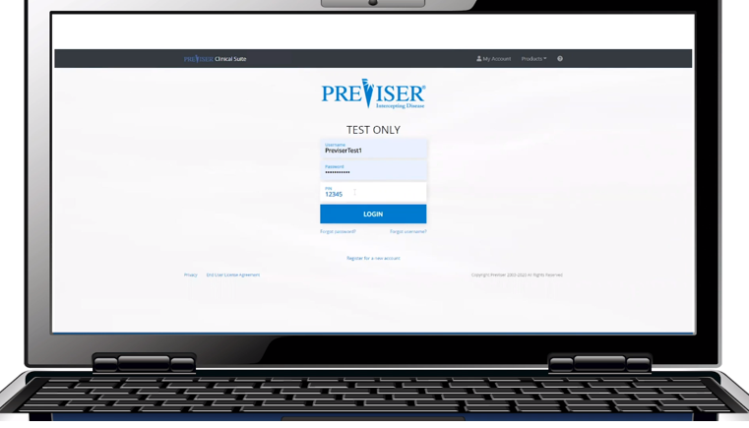
Click by click:
Log in with username, password, and PIN number

Slide 5
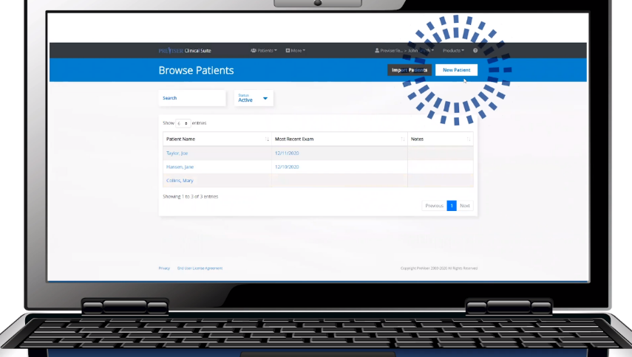
Click by click:
Select “New Patient”

Slide 6
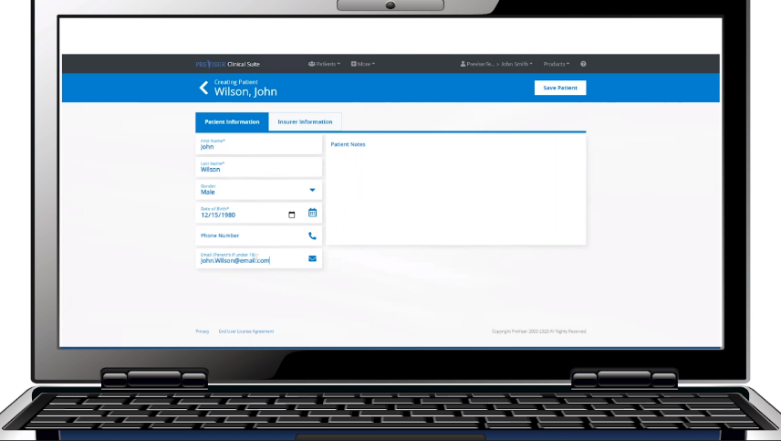
Click by click:
Enter in the “Patient Information” including:
First name
Last name
Gender
Date of birth
Any addition info

Slide 7
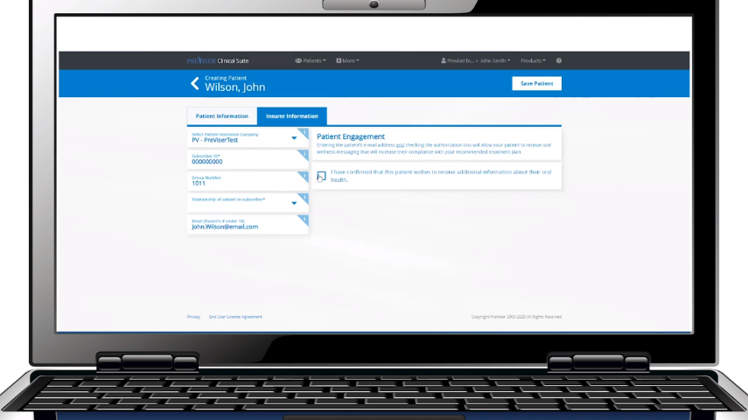
Click by click:
Enter in the “Insurance Information” as indicated by the asterisk

Slide 8
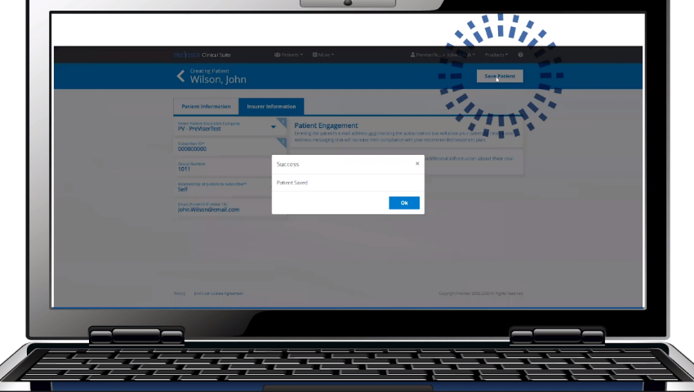
Click by click:
Select “Save Patient”

Slide 9
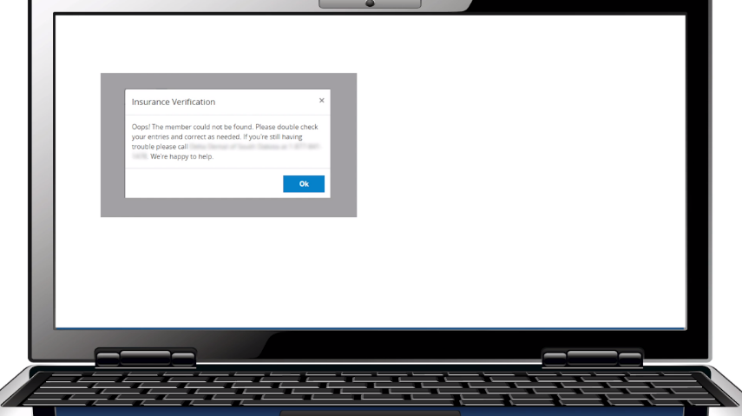
Click by click:
If you encounter the “Oops” message, select “Ok” and correct the patient information

Slide 10
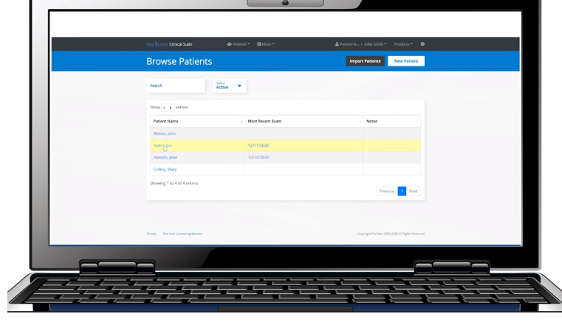
Click by click:
To edit a patient, select the patient’s name from the Browse Patient list

Slide 11
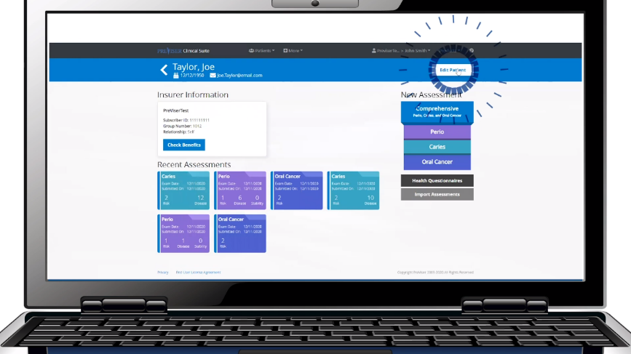
Click by click:
Select “Edit Patient”

Slide 12
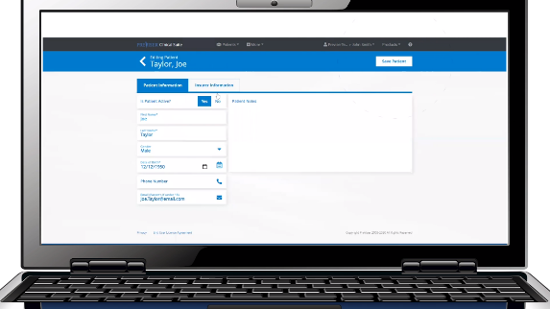

Click by click:
Update any “Patient Information” or “Insurance Information”

Slide 13
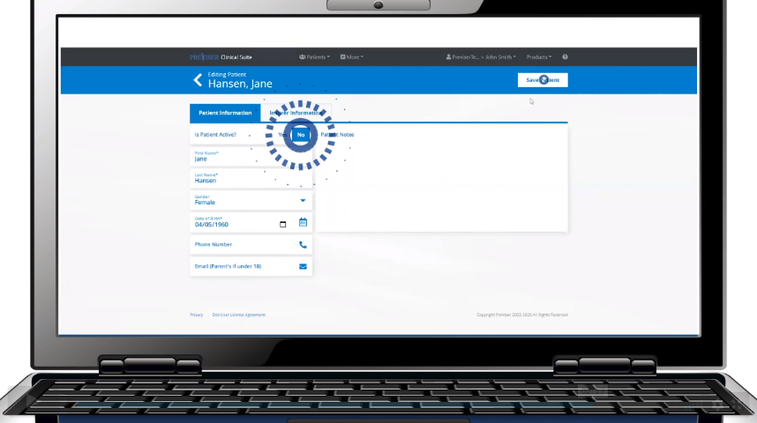
Click by click:
To inactivate a patient, select “No” patient is not active

Slide 14
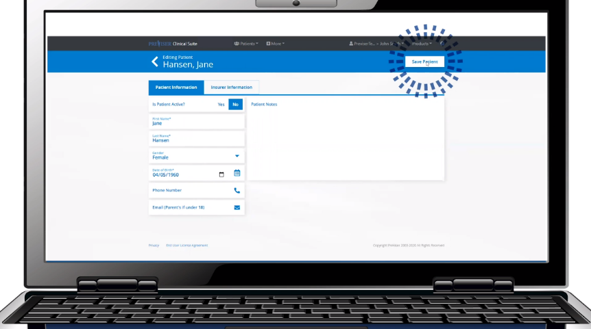
Click by click:
Select “Save Patient” to save any changes made to the patient’s account

Slide 15


Health Questionnaire

Slide 16
Overview
Click by click:
Health Questionnaire (Email) Select Patient Name | Health Questionnaire | Send by Email | Verify or Enter Patient Email | Send
Health Questionnaire (QR Code) Select Patient Name | Health Questionnaire | QR Code | Have Patient Scan QR Code

Slide 17
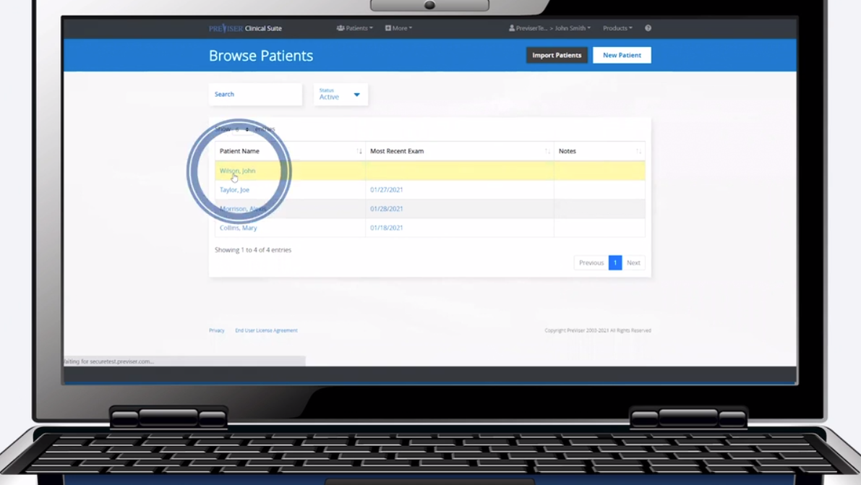
Click by click:
Select patient name

Slide 18
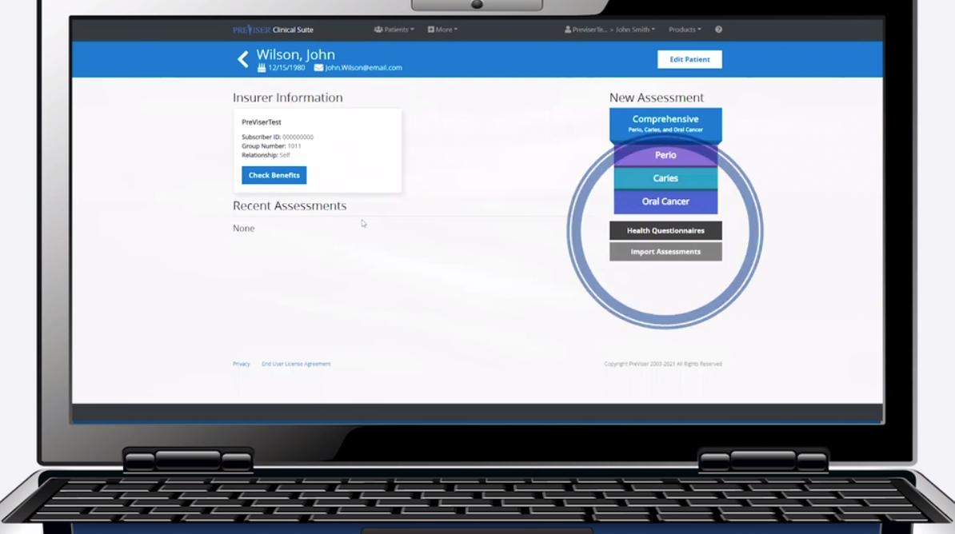
Click by click:
Select Health Questionnaire

Slide 19
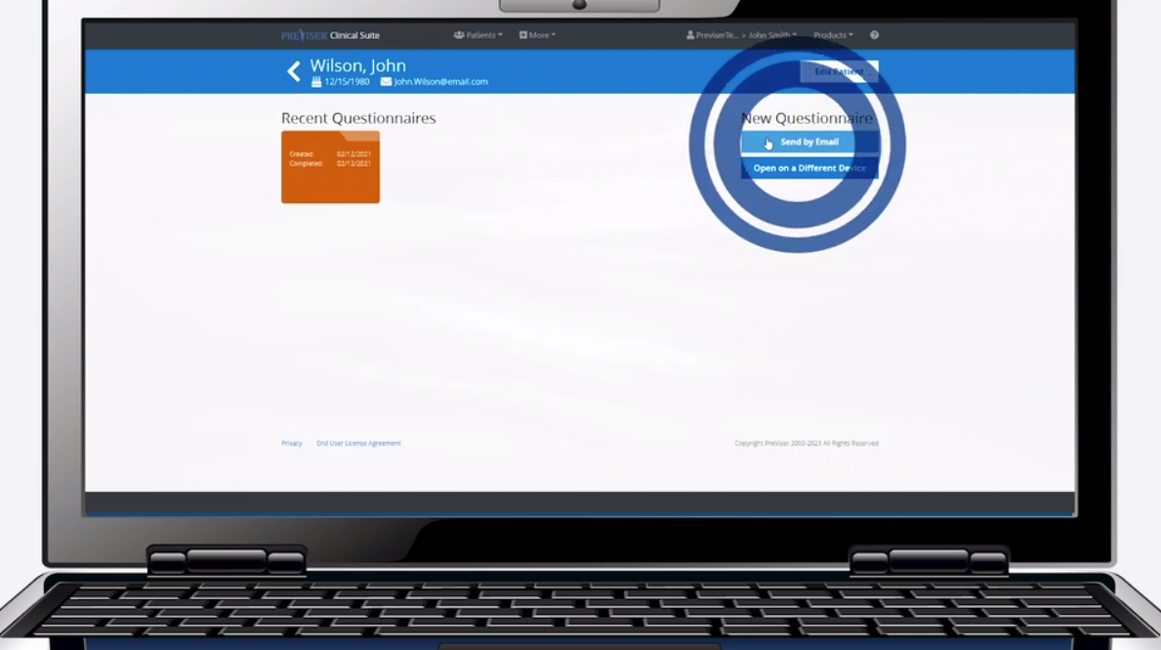
Click by click:
Select “Send by Email”

Slide 20
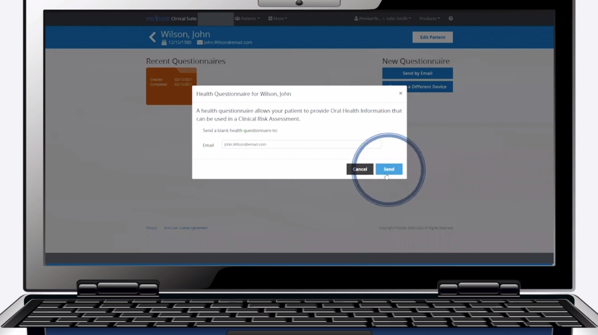
Click by click:
Verify/enter in email and select “Send”

Slide 21
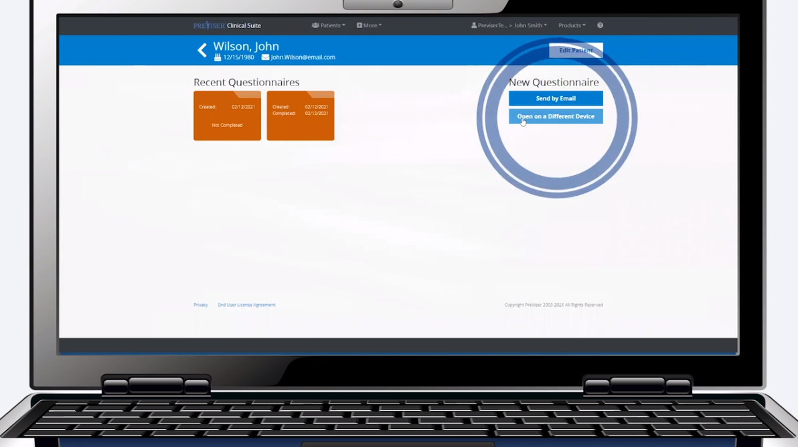
Click by click:
Select “Open on a Different Device”

Slide 22
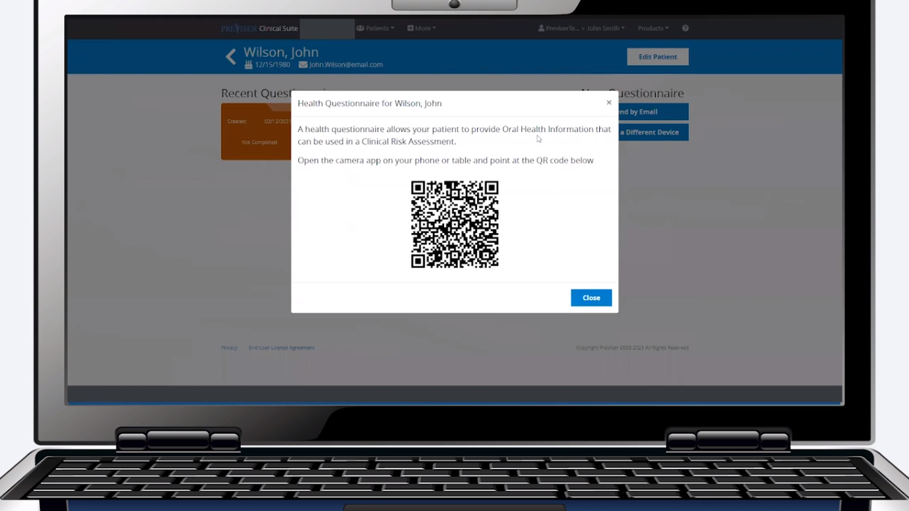
Click by click:
QR code will appear

Slide 23

Click by click:
Have patient open “Camera App” on mobile device

Slide 24
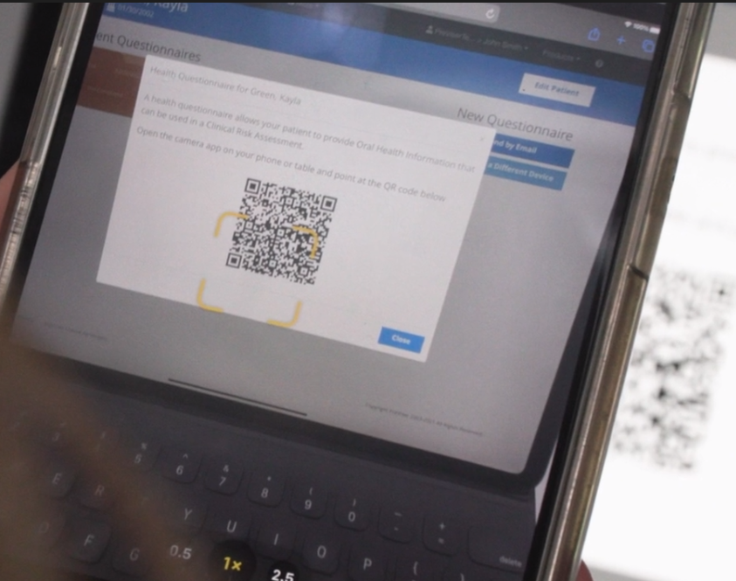
Click by click:
Scan QR code

Slide 25
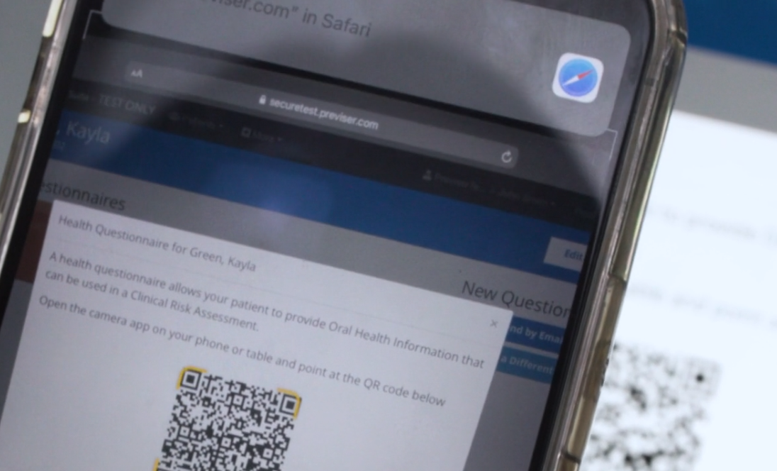
Click by click:
Tap pop-up link

Slide 26
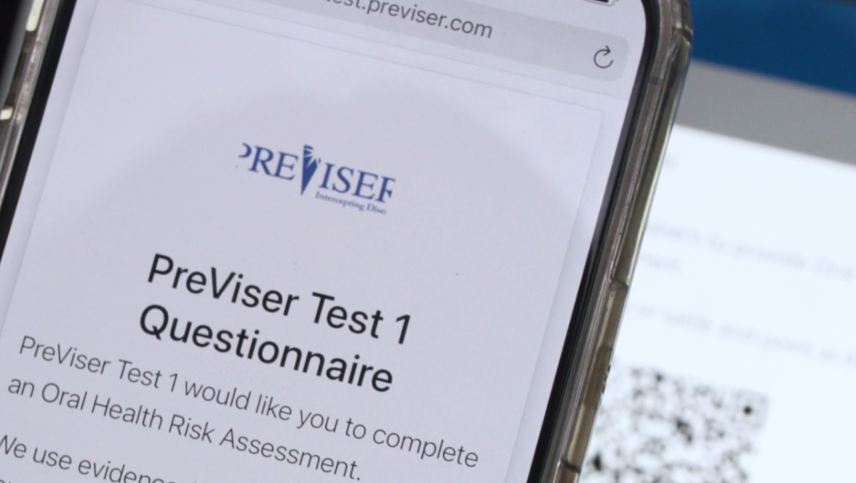
Click by click:
Patient will complete Health Questionnaire

Slide 27
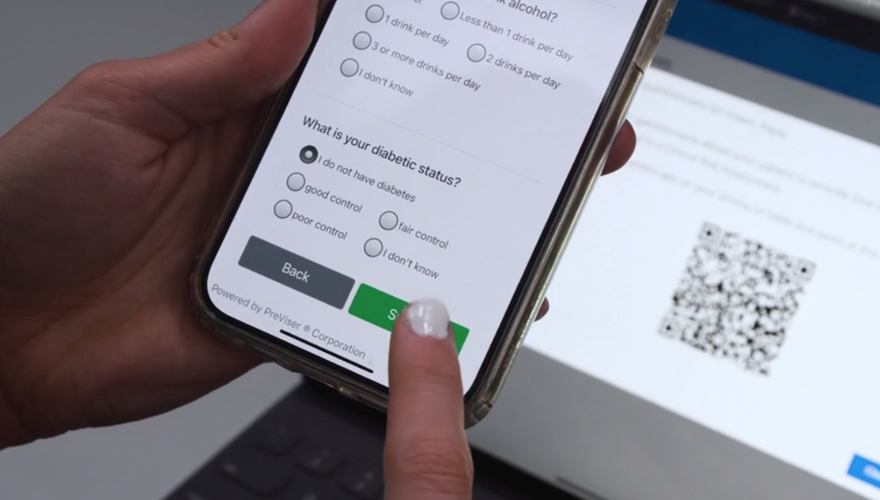
Click by click:
Patient will “Submit” questionnaire

Slide 28
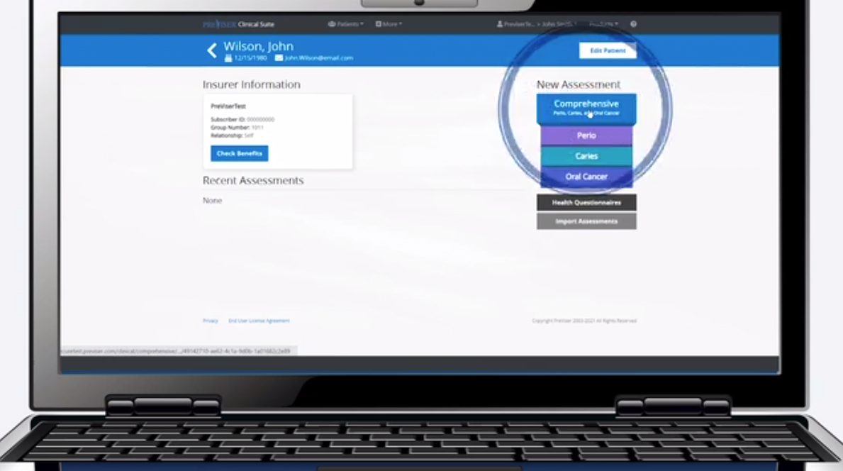
Click by click:
Clinician select desired assessment

Slide 29
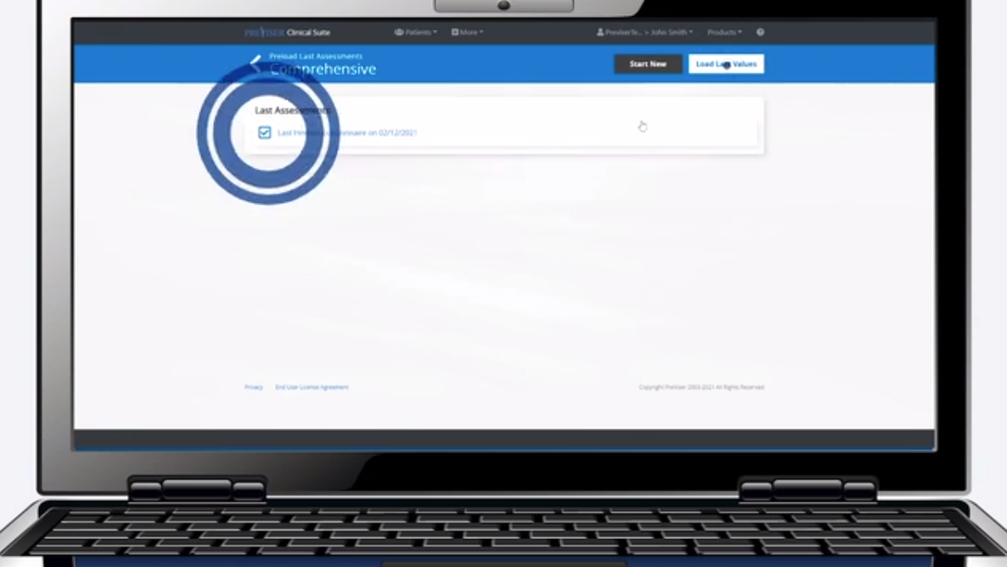
Click by click:
Be sure the last “Health Questionnaire is selected

Slide 30
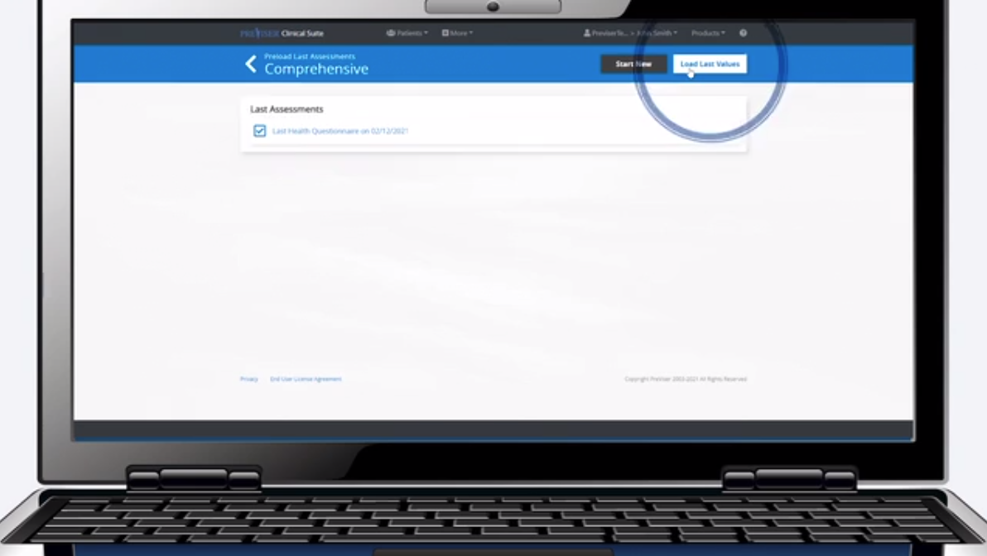
Click by click:
Select “load last values”

Slide 31
Comprehensive Assessment Overview

Slide 32
Overview
Click by click:
Complete New Assessment Select Patient Name | Select Desired Assessment | Responsible Clinician | Answer Remaining Questions | Submit

Slide 33
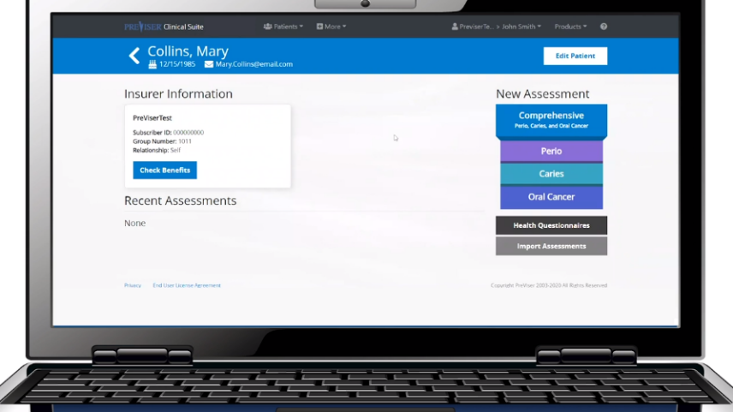
Click by click:
Select desired assessment:
Comprehensive
Perio
Caries
Oral Cancer

Slide 34
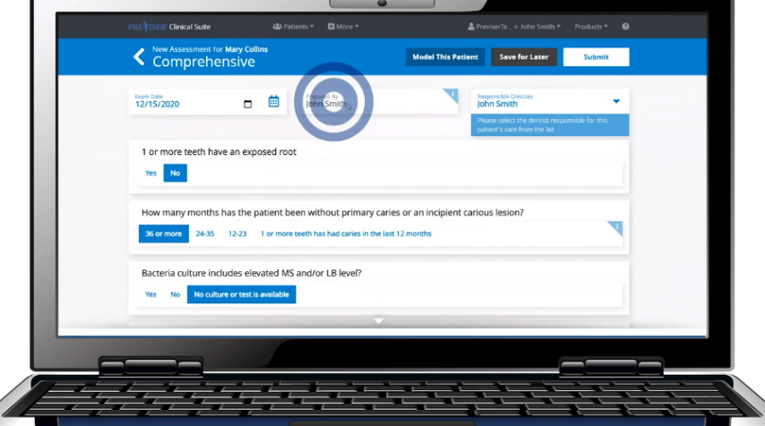
Click by click:
Enter in the “Prepared by” box who is completing the assessment

Slide 35
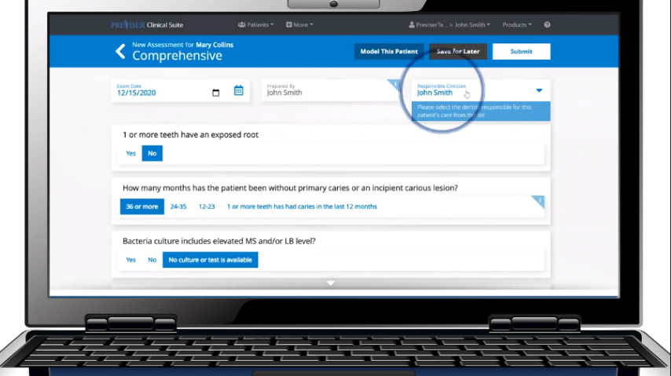
Click by click:
Select the “Responsible Clinician” from the drop-down menu

Slide 36
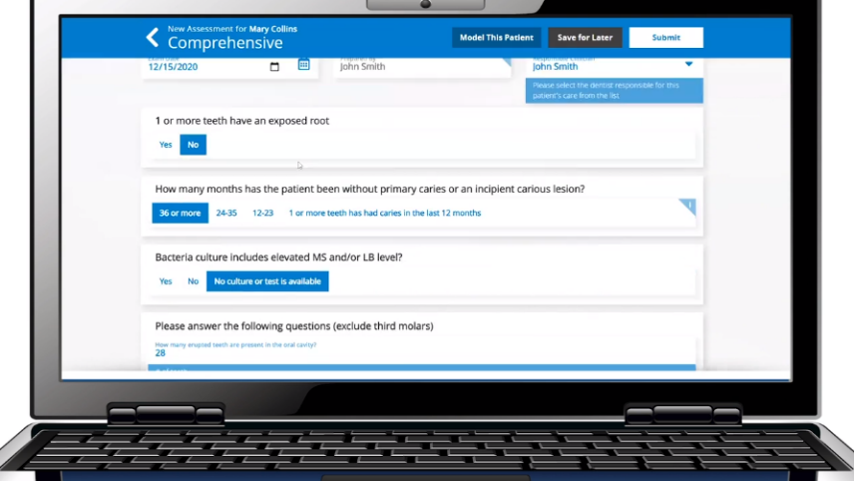
Click by click:
Complete the assessment

Slide 37
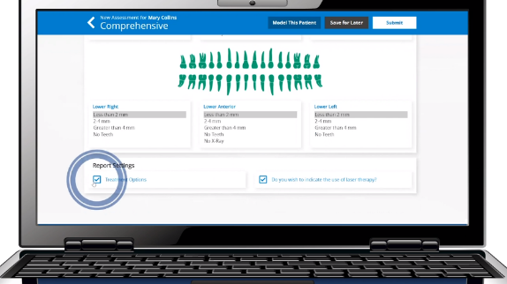

Click by click:
Select “Treatment Options” to include in the report
Select “Laser Therapy” if that is a technology in your office

Slide 38
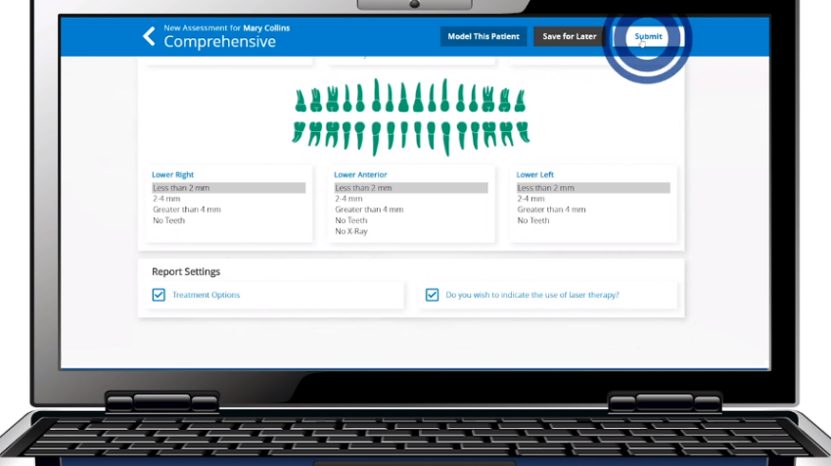
Click by click:
Select “Submit”

Slide 39
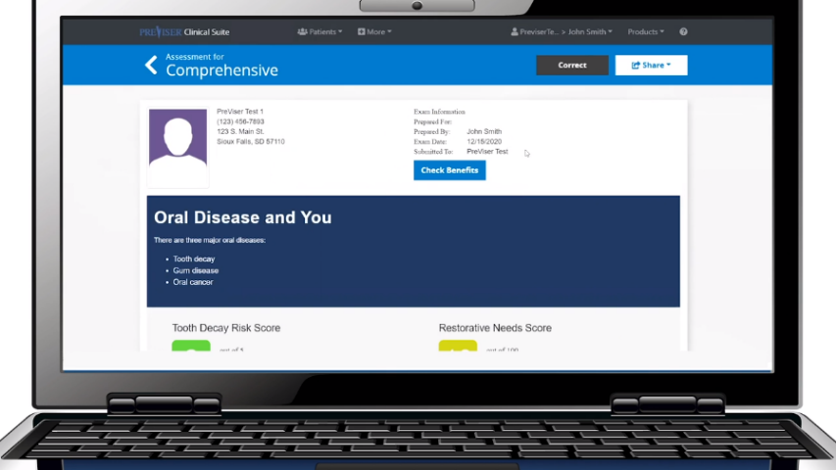
Click by click:
View the patient report, recommend a treatment plan and share it with the patient

Slide 40
Finishing an Assessment – Buttons Overview

Slide 41
Overview
Click by click:
Save Assessment Select Patient Name | Select Desired Assessment | Input Responsible Clinician | Answer Assessment Questions | Save for Later | Under “Recent Assessments” select “Unfinished Assessment” | Finish Assessment | Submit
Model this Patient Select Patient | Select Desired Assessment | Input Responsible Clinician | Answer Assessment Questions | Model this Patient
Submit Assessment Select Patient | Select Desired Assessment | Input Responsible Clinician | Answer Assessment Questions | Submit

Slide 42
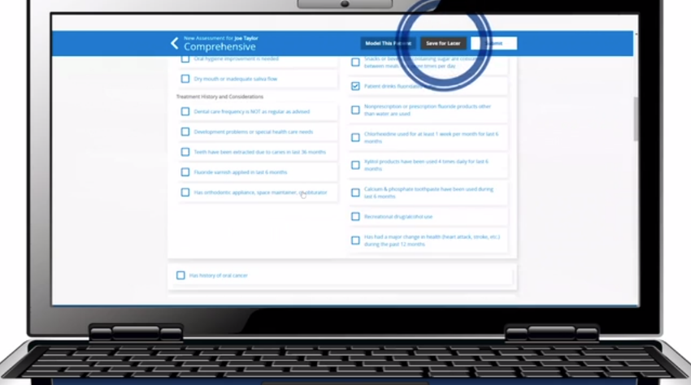
Click by click:
Select “Save for Later” if you are not able to complete an assessment at this time

Slide 43
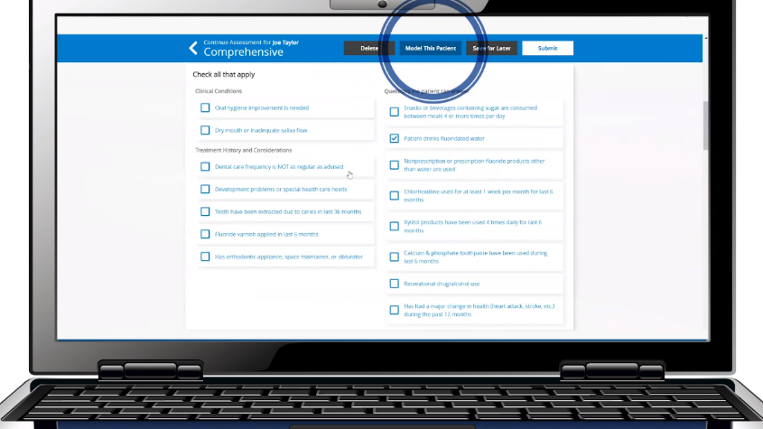
Click by click:
Select “Model this Patient”

Slide 44
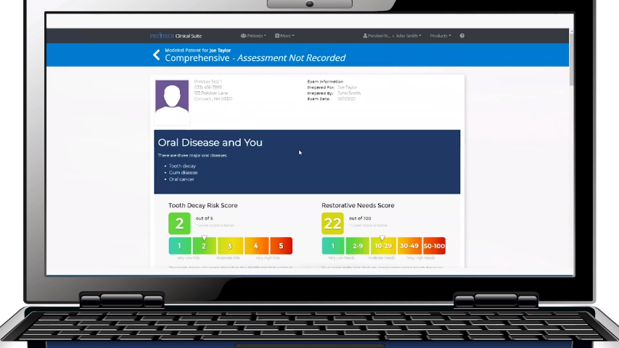
Click by click:
View the hypothetical report

Slide 45
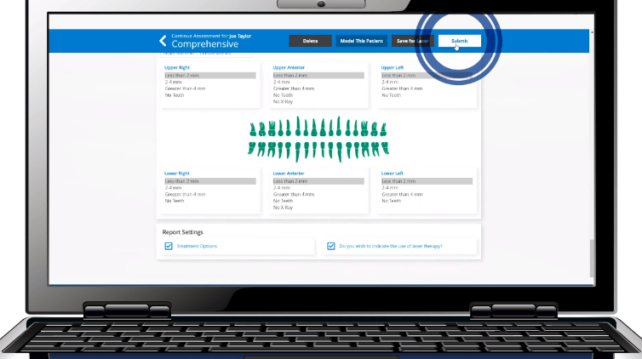
Click by click:
Select “Submit”

Slide 46
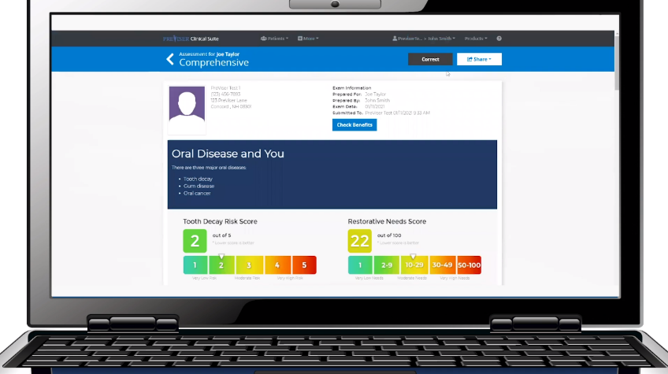
Click by click:
View the report

Slide 47
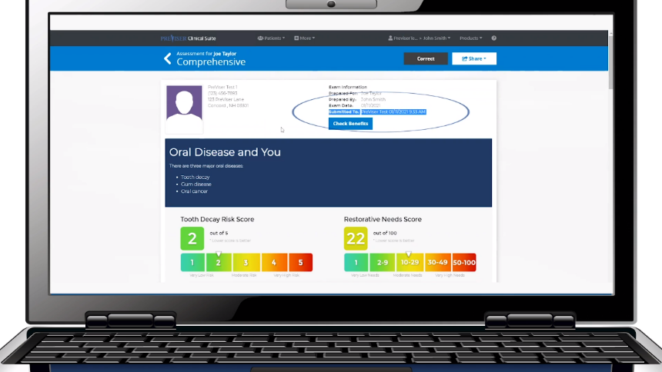
Click by click:
If there is Insurance on file, verify the assessment was submitted to the company

Slide 48
Report Details

Slide 49
Overview
Click by click:
Report Details Overview report details

Slide 50
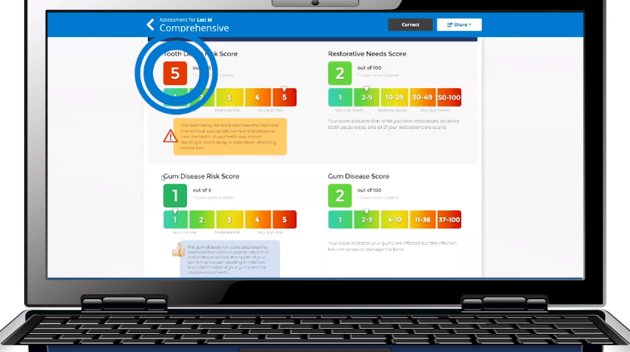
Click by click:
Evaluate “Tooth Decay Risk Score”

Slide 51
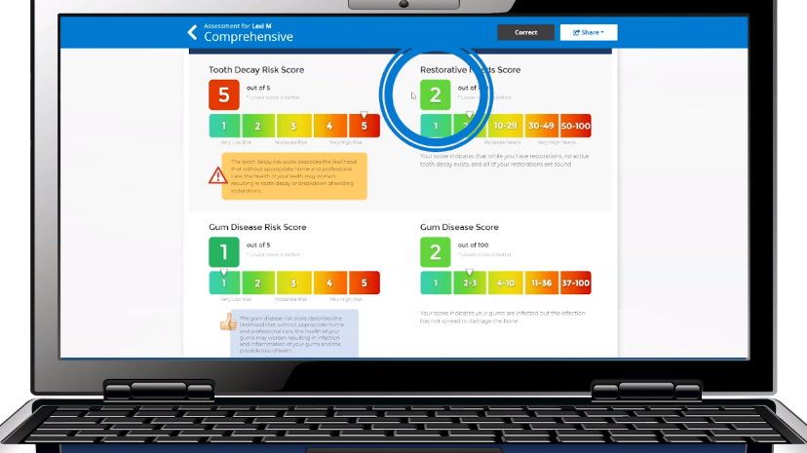
Click by click:
Evaluate “Restorative Needs Score”

Slide 52
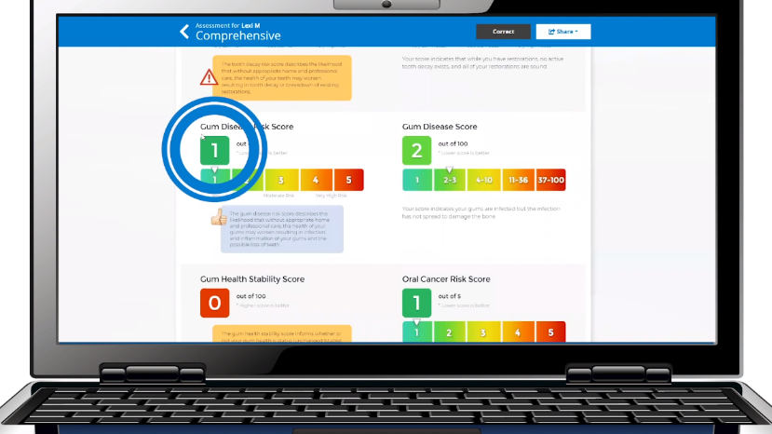
Click by click:
Evaluate “Gum Disease Risk Score”

Slide 53
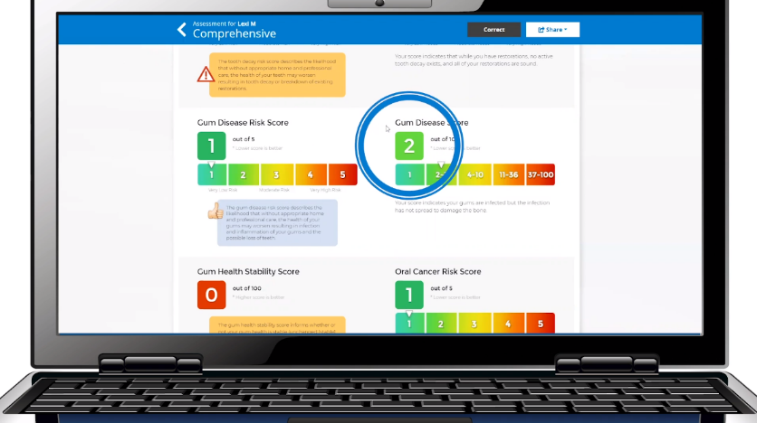
Click by click:
Evaluate “Gum Disease Score”

Slide 54
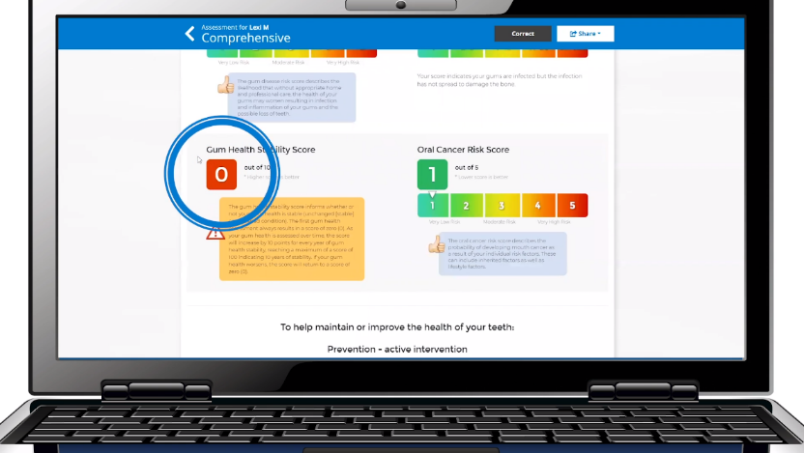
Click by click:
Evaluate “Gum Health Stability Score”

Slide 55
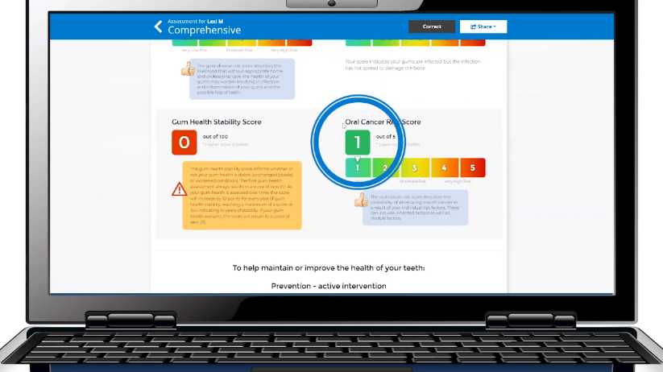
Click by click:
Evaluate “Oral Cancer Risk Score”

Slide 56
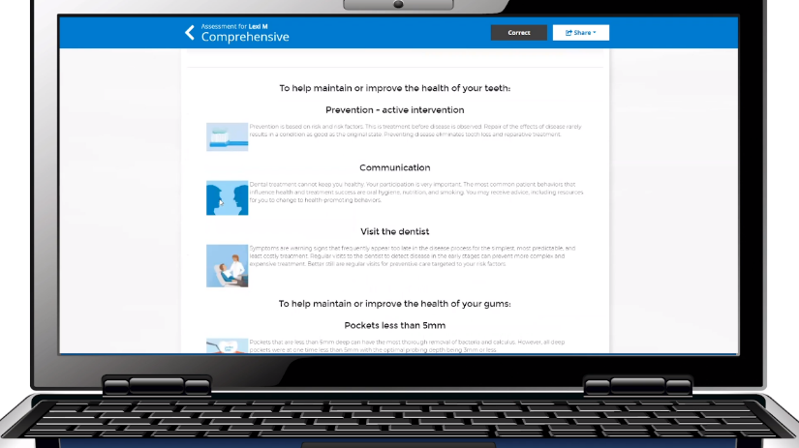
Click by click:
Evaluate Report

Slide 57
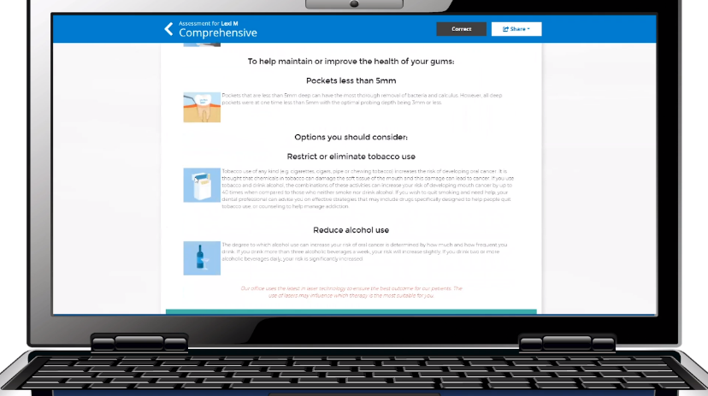
Click by click:
Evaluate Report

Slide 58
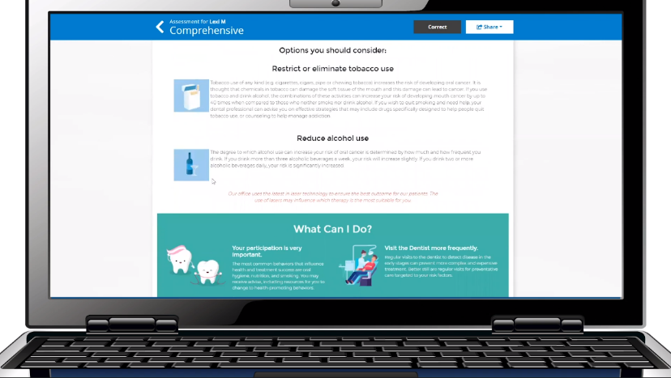
Click by click:
Evaluate Report

Slide 59
Additional Patient Benefits from Insurance

Slide 60
Overview
Click by click:
Additional Patient Benefits from Insurance Patient Name | Assessment - Complete Assessment | Submit | Check Benefits | Check Enhanced Benefits & Click Here Link | Copy to Notes or Practice Management System

Slide 61
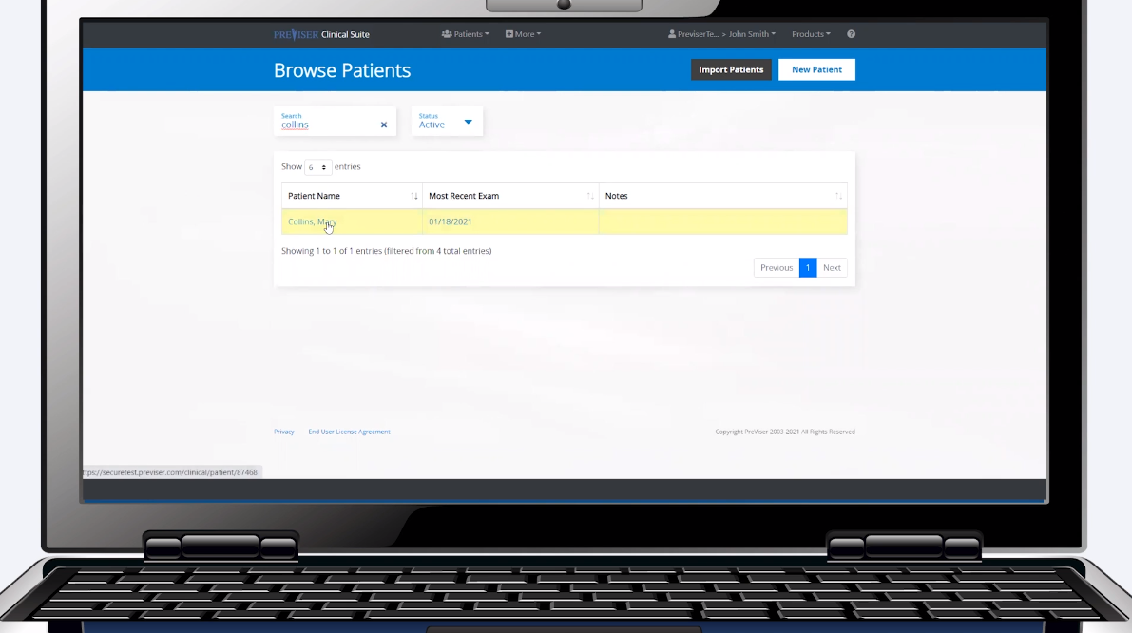
Click by click:
Select patient name

Slide 62
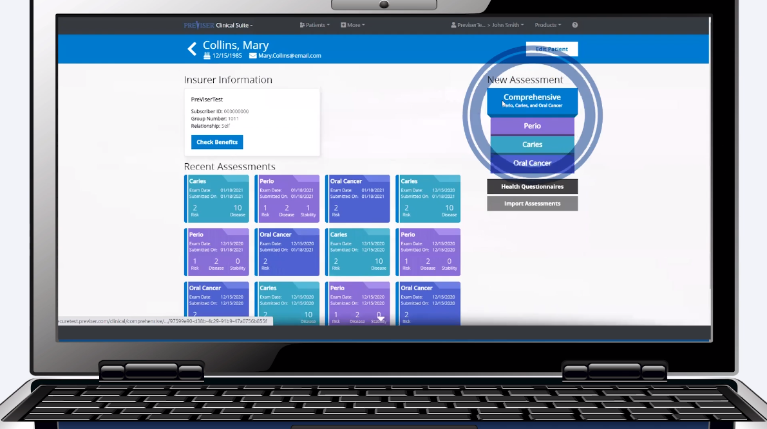
Click by click:
Select desired assessment

Slide 63
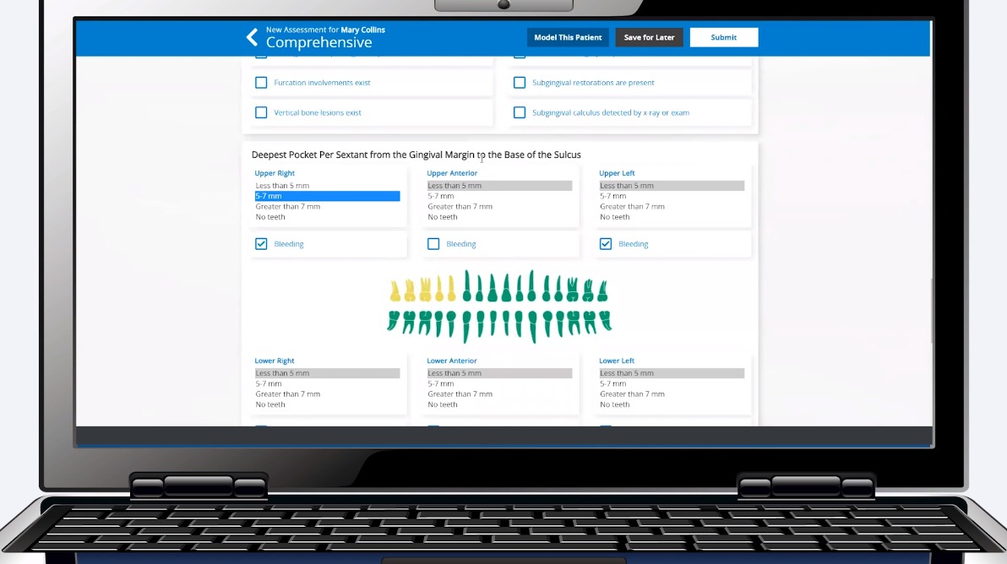
Click by click:
Fill out assessment

Slide 64
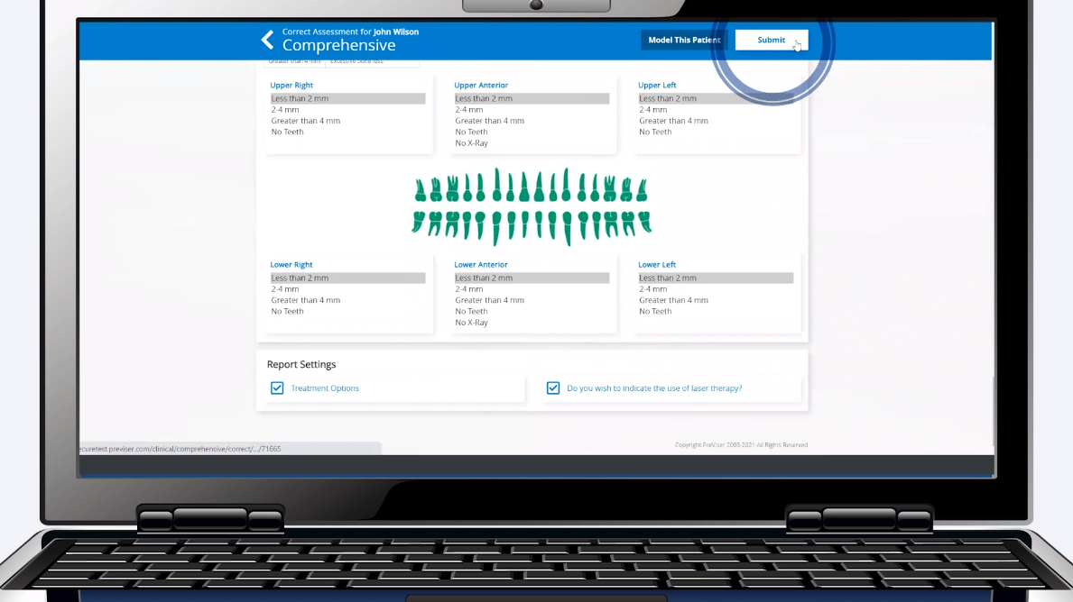
Click by click:
Select “Submit”

Slide 65

Click by click:
Select “Check Benefits”

Slide 66

Click by click:
Browse insurance information and select “Click Here”

Slide 67

Click by click:
Select “Copy”

Slide 68

Click by click:
Select “Edit Patient”

Slide 69

Click by click:
Find “Patient Notes”

Slide 70

Click by click:
Paste additional benefits into “Patient Notes”. For future reference, check eligibility with insurance company to determine if additional benefits are active

Slide 71

Click by click:
Select “Save Patient"

Slide 72
Sharing Reports with Patients

Slide 73
Overview
Click by click:
Share Report with Patient (Email) Submit Report | Share | Email | Verify email/Enter email | Ok | Verify Patient Received Report
Share Report with Patient (Print) Submit Report | Share | Print | Give to patient

Slide 74

Click by click:
Select “Share”

Slide 75

Click by click:
Select “Email” and enter/verify email. Select “Ok” to send

Slide 76

Click by click:
Select “Share”. Select “Print”

Slide 77

Click by click:
Print the report

Slide 78




Click by click:
Share the report with the patient by:
Print out
Computer
iPad
Mobile device via email

Slide 79
Importing a PreViser Assessment from a Referring Office

Slide 80
Overview
Click by click:
Import Assessment from a Referring Office Find Access Code at Bottom of Report | Patient Name | Import Assessment | Type in Access Code | Import

Slide 81

Click by click:
Select “New Patient”

Slide 82

Click by click:
Enter in the Patient Information

Slide 83

Click by click:
Enter in the Insurance Information

Slide 84

Click by click:
Select “Save” and “Ok”

Slide 85

Click by click:
Select “Import Assessment”

Slide 86

Click by click:
Enter in the Clinical Access Code

Slide 87

Click by click:
Select “Import”

Slide 88
Follow-up Risk Assessment

Slide 89
Overview
Click by click:
Follow-up Risk Assessment (Load Last Values Button) Patient Name | Choose Assessment | Check all Assessments you want to Import | Load Last Values | Complete Assessment | Submit

Slide 90
Click by click:
Select patient name

Slide 91
Click by click:
Select desired assessment

Slide 92

Click by click:
Check all assessments you want to load

Slide 93

Click by click:
Select “Load Last Values”

Slide 94
Click by click:
Fill out only what has changed with the patient’s oral health

Slide 95

Click by click:
Select “Submit”

Slide 96


PreViser Corporation
T: 888-854-0007 | help@previser.com
© Copyright 2020 PreViser Corporation

